Slide 1



How to Guide OBS Studio
1 of 3
Dr. Emile Hurts Jr.

Slide 2
OBS How to Guide
OBS, or Open Broadcaster Software, is a free, open-source program for recording videos and live streaming:
Features: Capture your screen, webcam, and other media sources. Customize your footage with scenes, transitions, and more. Stream directly to platforms like YouTube, Twitch, and Facebook.
Availability: Available for Windows, macOS, Linux distributions, and BSD.
Ease of use: Offers a streamlined Settings panel with many configuration options. You can also use hotkeys for actions like switching between scenes, starting and stopping streams, and muting audio sources.
Community: Programmers can contribute their coding skills to the platform via GitHub. The OBS Project is funded by sponsors and backers.
Considered a precursor: OBS Studio is considered the precursor to all modern streaming software.
To get started with OBS, you can:
Download and install OBS Studio from the official website
Select your video source
Select your output settings
Click "Start Recording"

Slide 3
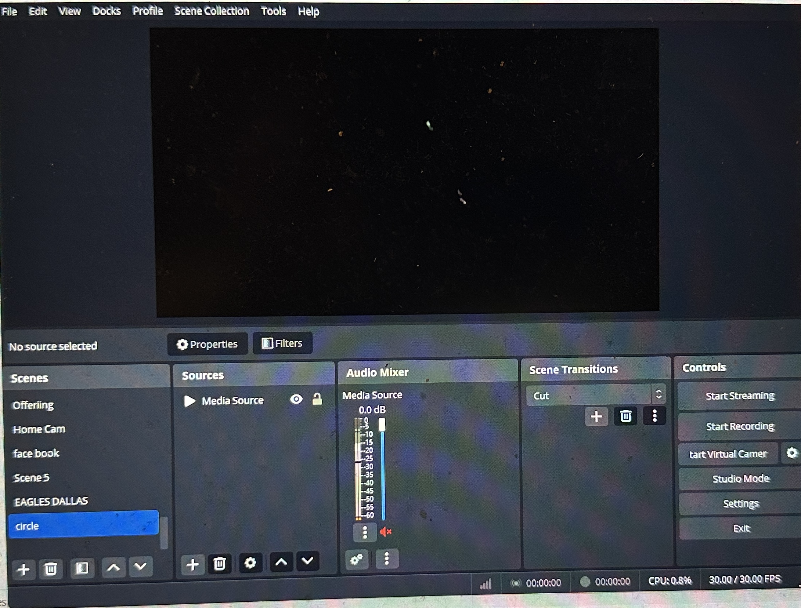
OBS Studio
Page 1.
Once you have successfully downloaded OBS
Scenes, Sources, AudioMixer, Scene Transition will be empty

Slide 4
OBS Studio
Page 2
Controls
Start Streaming
Start Recording
Start Virtual Camera
Studio Mode
Settings
Exit

Slide 5
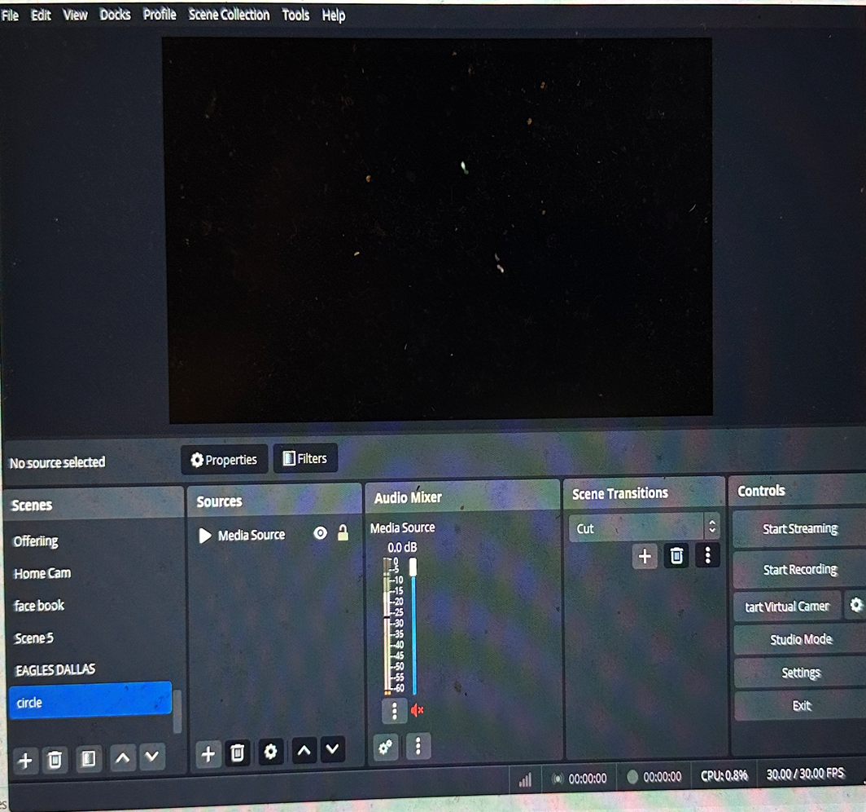
OBS Studio
Scenes
Sources
Audio Mixer
Scene Transition
Example
Page 3
Scenes
By placing curser in the scene block right click to add scene and scene name. Scenes may contain images, titles, videos these scenes can be scrolled between or deleted

Slide 6
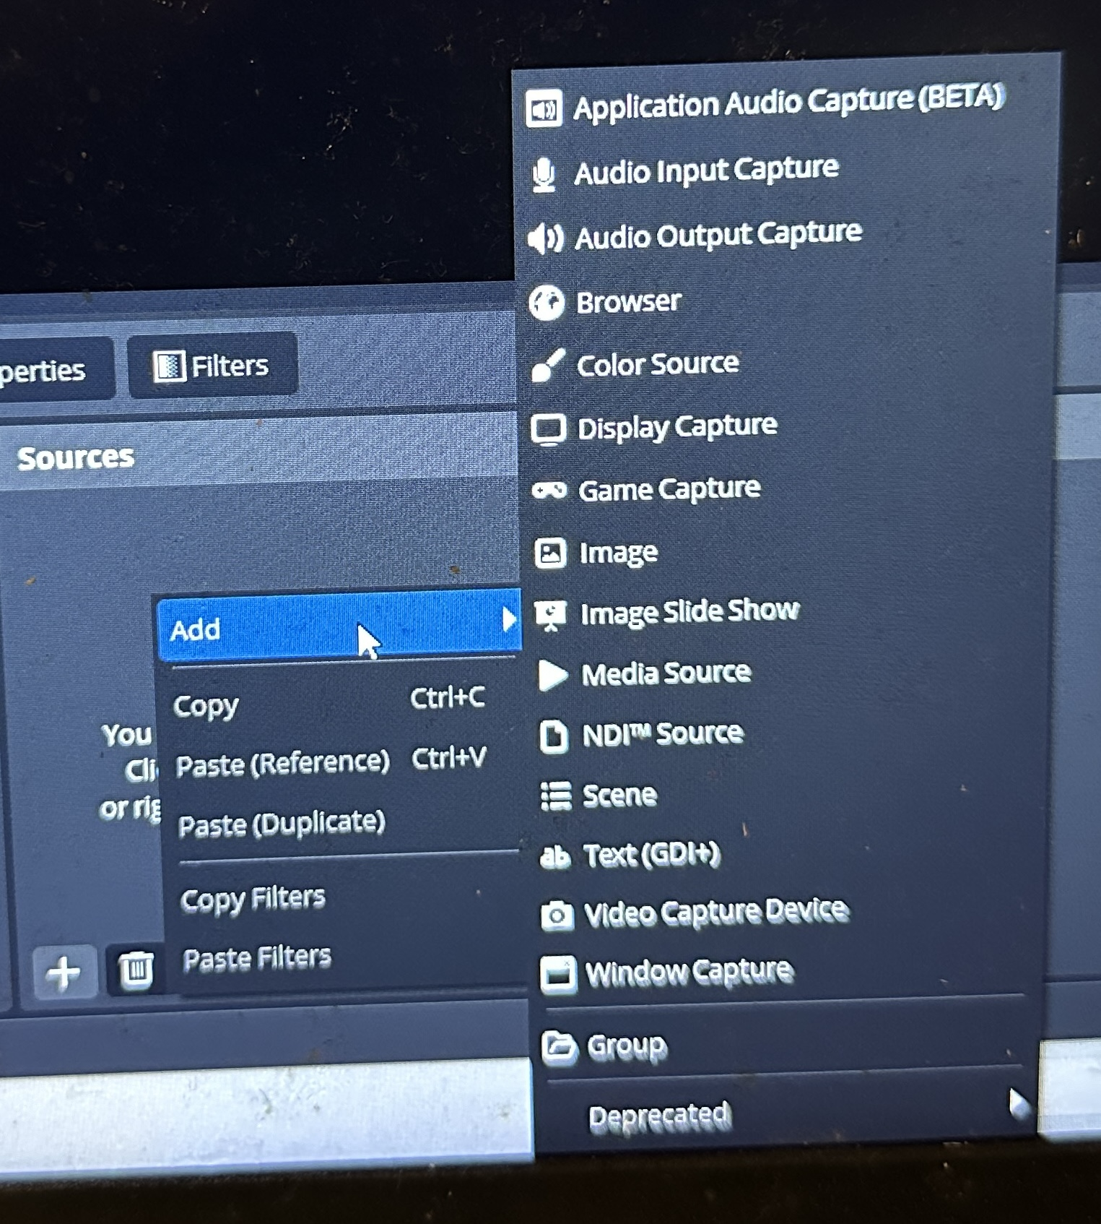
OBS Studio
Page 4
Sources
Right click under source
Click on add this screen should appear

Slide 7
OBS Studio
Page 5
Sources : will open up into your main windows for video, audio, images and display.

Slide 8
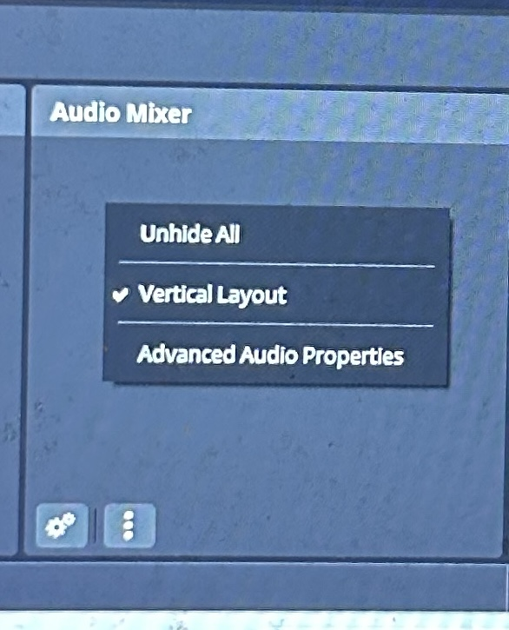
OBS Studio
Page 6
Audio Mixer:
Right click to open audio click unhide all to show all audio inputs

Slide 9
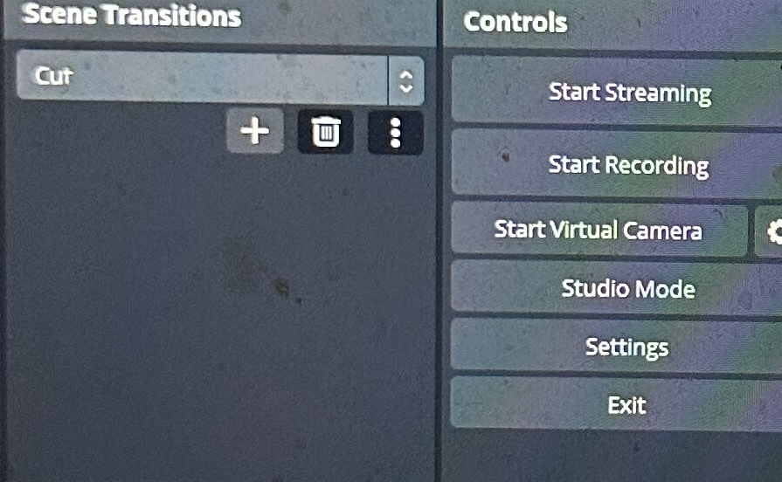
OBS Studio
Page 7
Scene Transitions:
Transitions slides to move between scenes even mixing video scenes

Slide 10
OBS Studio
Page 8
Controls:
Start Streaming
Start Recording
Start Virtual Camera
Studio Mode
Settings

Slide 11
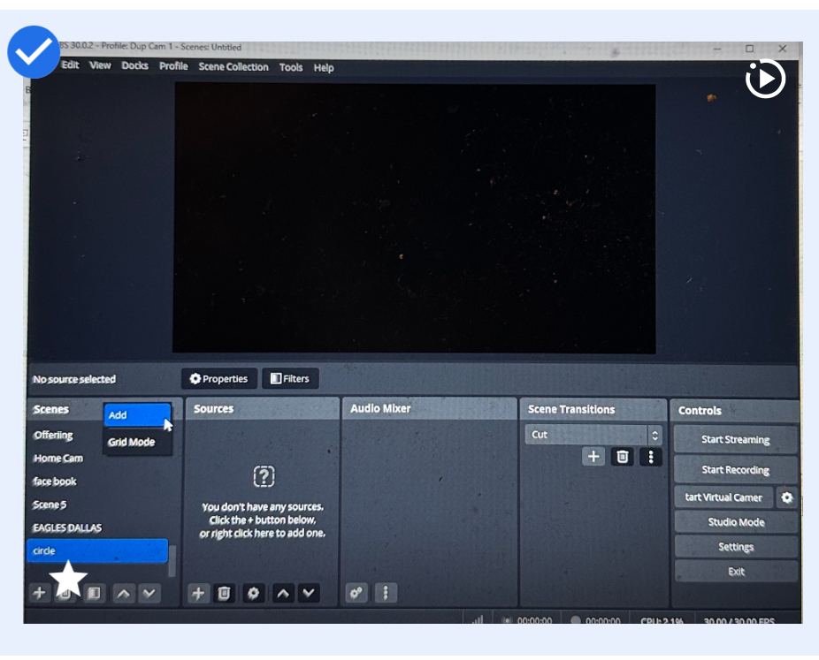
OBS Studio
Section 1 A.
How to start Video Capture
a. Move cursor to scene right click to add

Slide 12
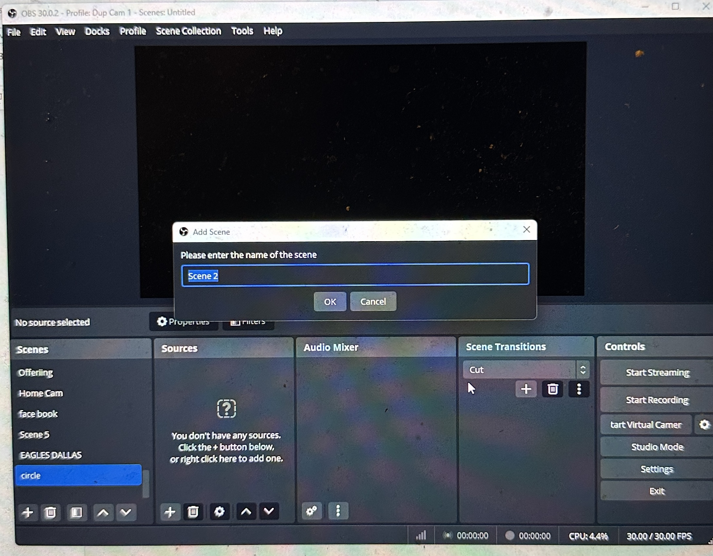
OBS Studio
Section 1 B. How to start Video Capture
How to start Video Capture
b. Click on your scene move cursor to Source

Slide 13
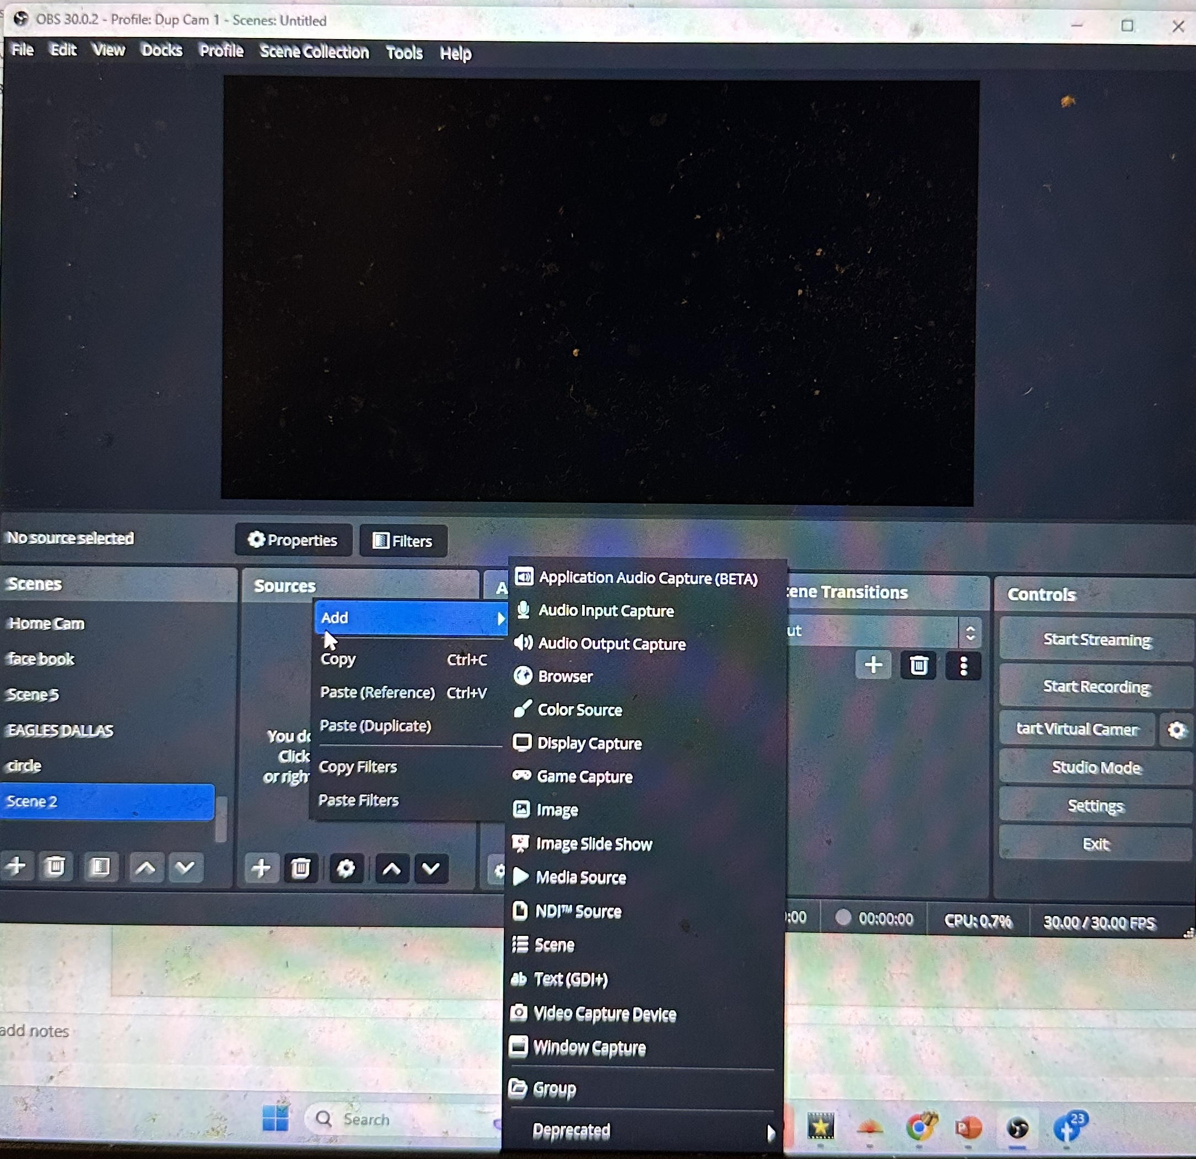
OBS Studio
Section 1 C.
How to start Video Capture
C. Move cursor to video capture and click

Slide 14
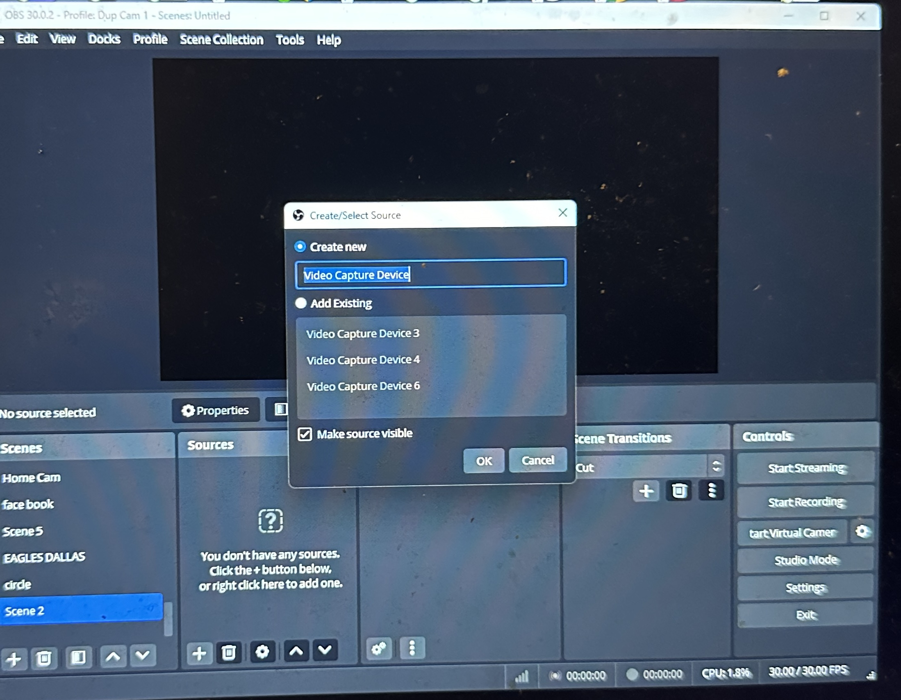
OBS Studio
Section 1 D.
How to start Video Capture
D. Click Ok Button

Slide 15
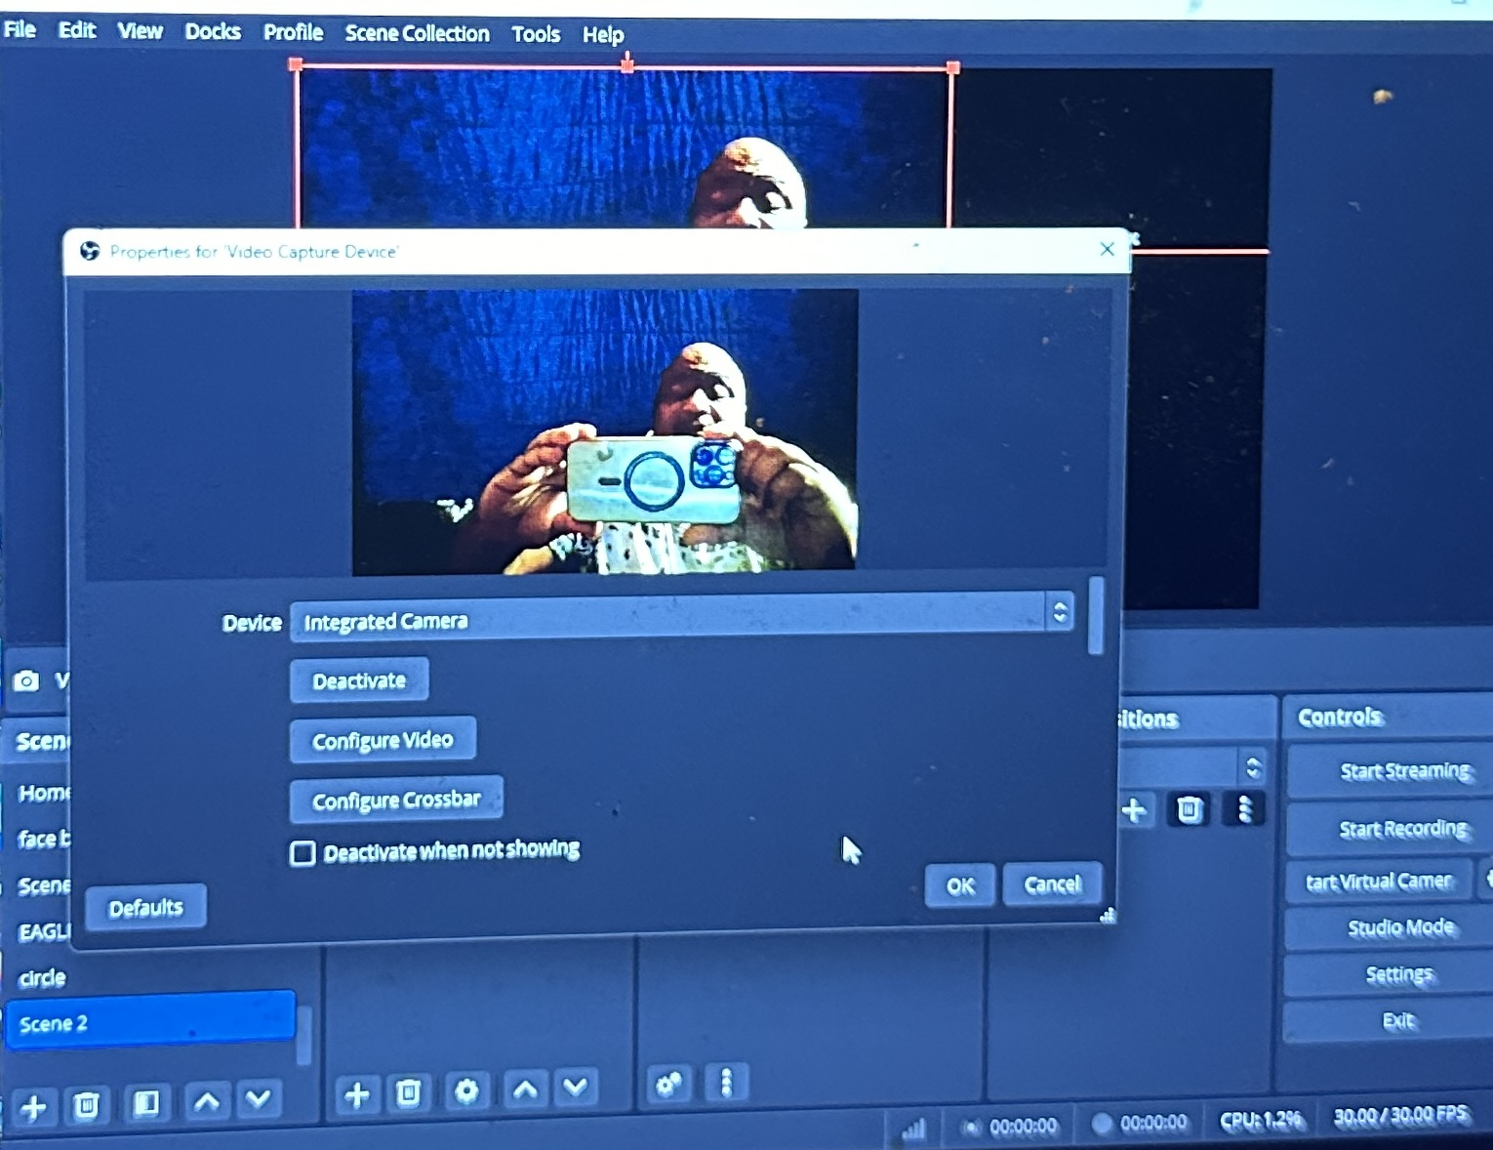
OBS Studio
Section 1 E.
How to start Video Capture
E. Click up or down button to select with Camera to choose then Click Ok

Slide 16
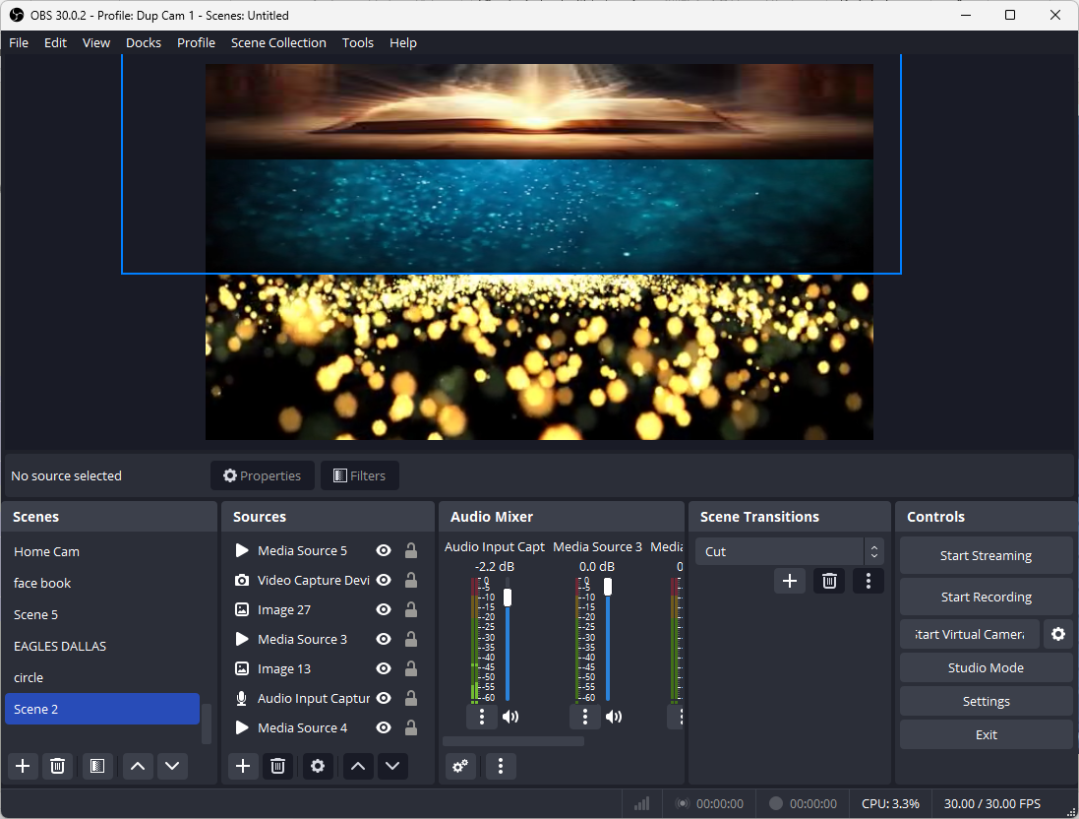
OBS Studio
Section 1 F.
How to start Video Capture
F. Click Studio Mode to open Dual Work Screen

Slide 17
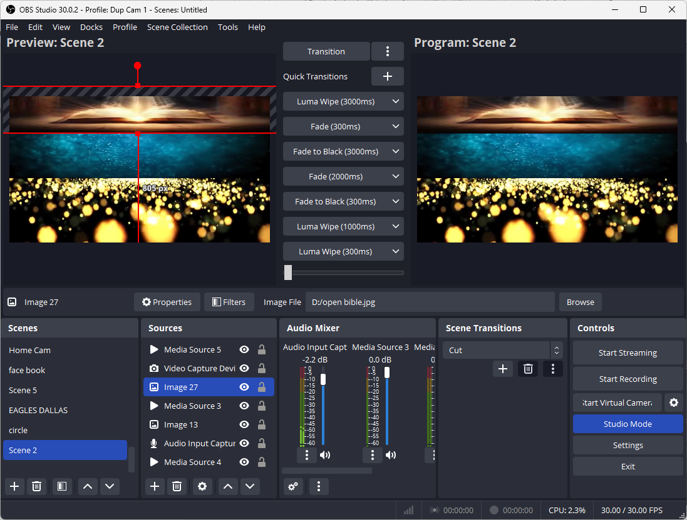
OBS Studio
Section 2. A
How to Broadcast Videos
Controls will act as your export to Facebook, YouTube, computer and storage files

Slide 18
OBS Studio
Section 2. A
How to Broadcast Videos
A. Controls will act as your export to Facebook, YouTube, computer and storage files

Slide 19
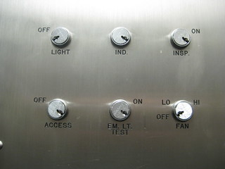
OBS Studio
Section 2. B
How to Broadcast Videos
B. Controls:
Start Streaming
Start Recording
Virtual Camera
Studio Mode
Settings

Slide 20
OBS Studio
Section 2. C
How to Broadcast Videos
Controls:
Start Recording
Click the Start the recording button will began recording in computer file found in computer videos.
Click stop recording to allow recording of computer file to stop

Slide 21
OBS Studio
Section 2. D
How to Broadcast Videos
Controls:
Settings
Click the settings button

Slide 22
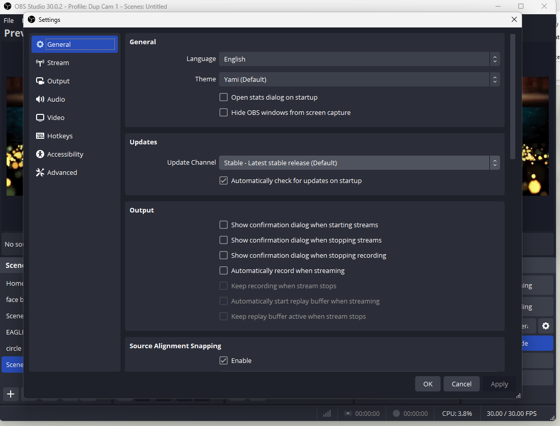
OBS Studio
Section 2. E
How to Broadcast Videos
Controls:
Stream
Click the Stream button

Slide 23
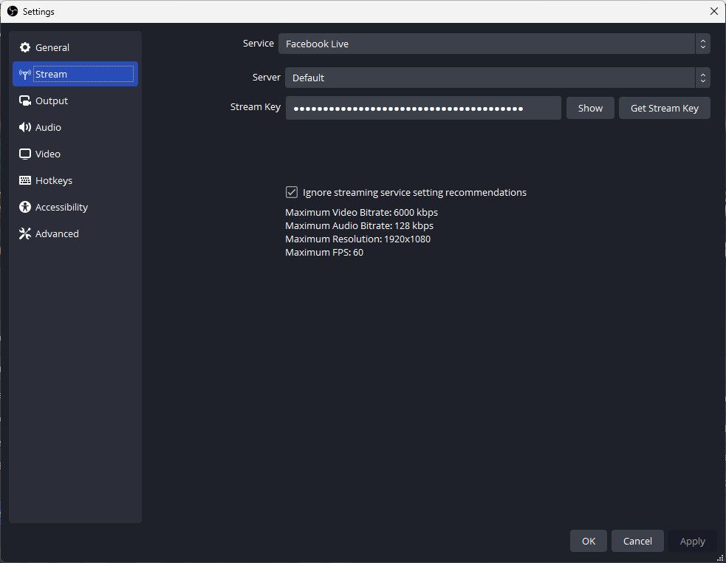
OBS Studio
Section 2. F
How to Broadcast Videos
Controls:
Stream Key
Left Click the Stram key back space all of the Dots

Slide 24
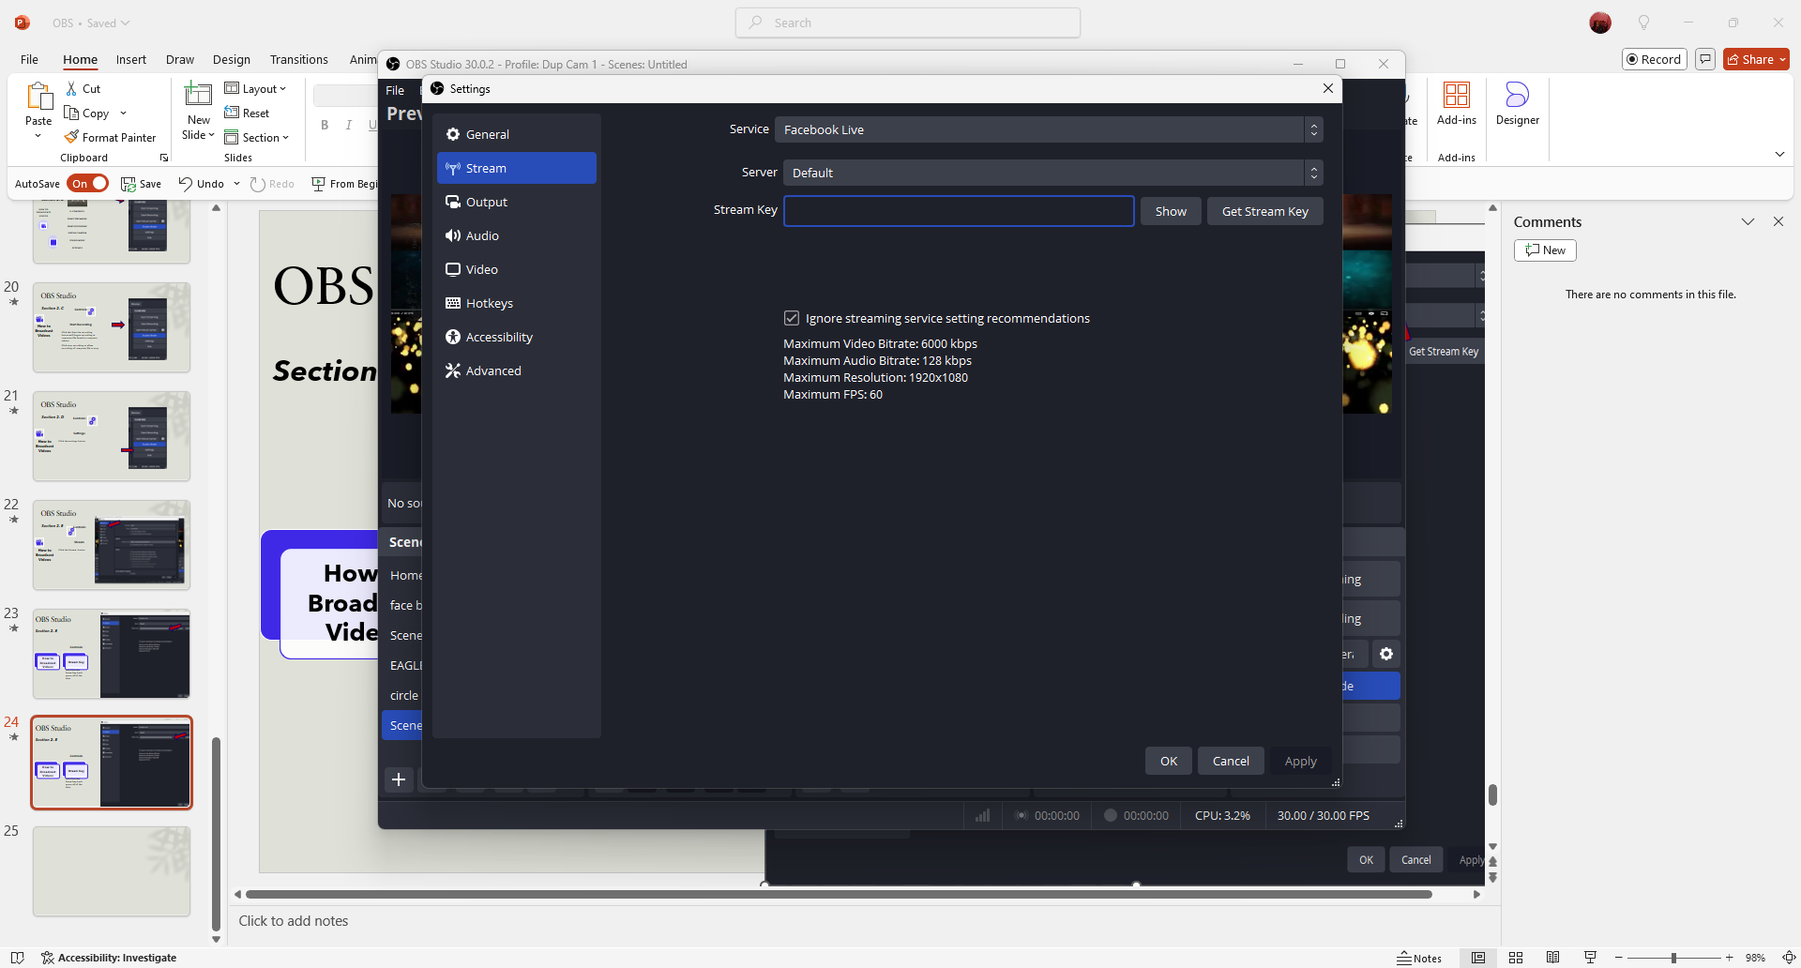
OBS Studio
Section 2. G
How to Broadcast Videos
Controls:
Stream Key
Open facebook tab copy stream key and paste in this place click apply then OK

Slide 25
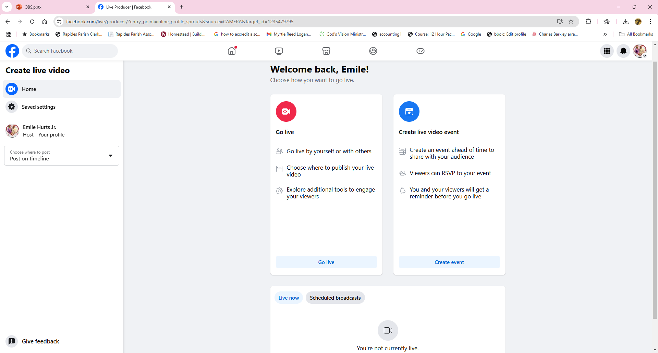
OBS Studio
Section 2. H
How to Broadcast Videos
Controls:
Stream Key
Click Go Live on Facebook Page

Slide 26
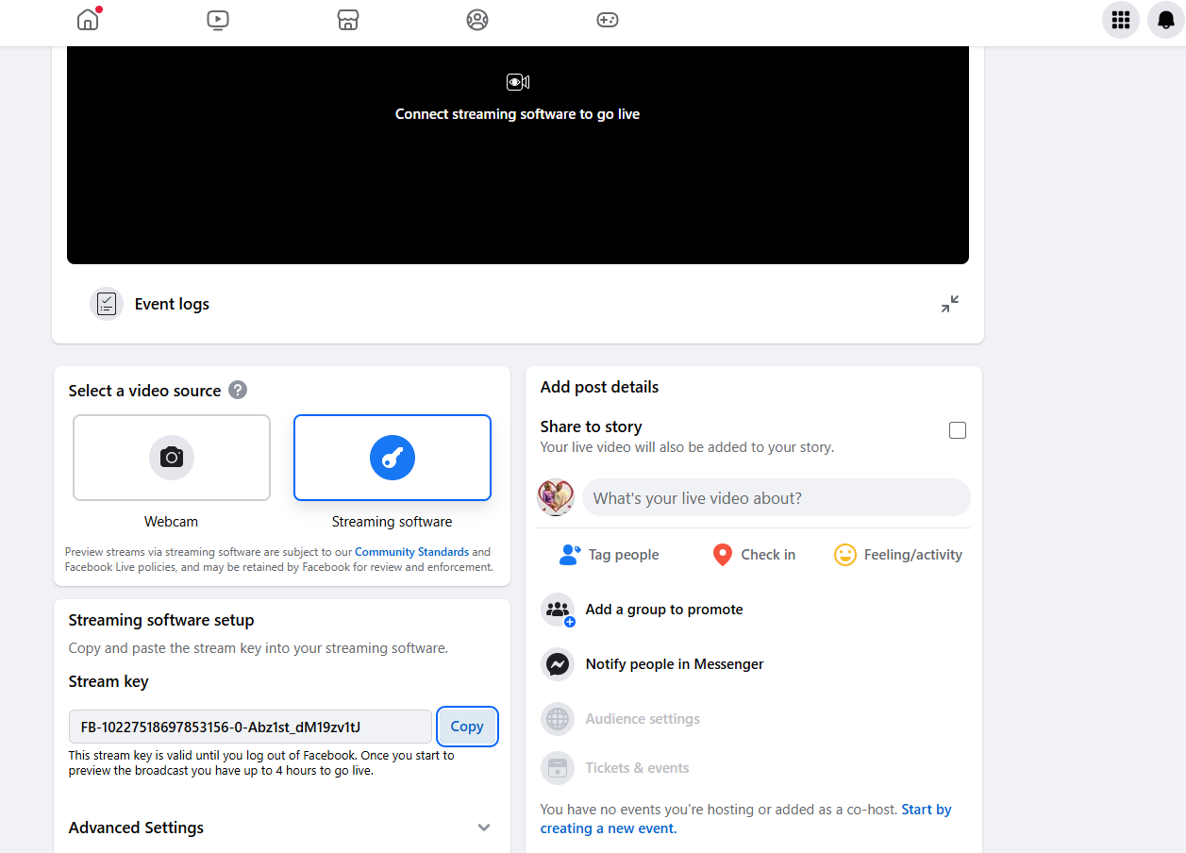
OBS Studio
Section 2. I
How to Broadcast Videos
Controls:
Stream Key
Left Click Stream Key
Left Click Copy Key
Return to OBS

Slide 27
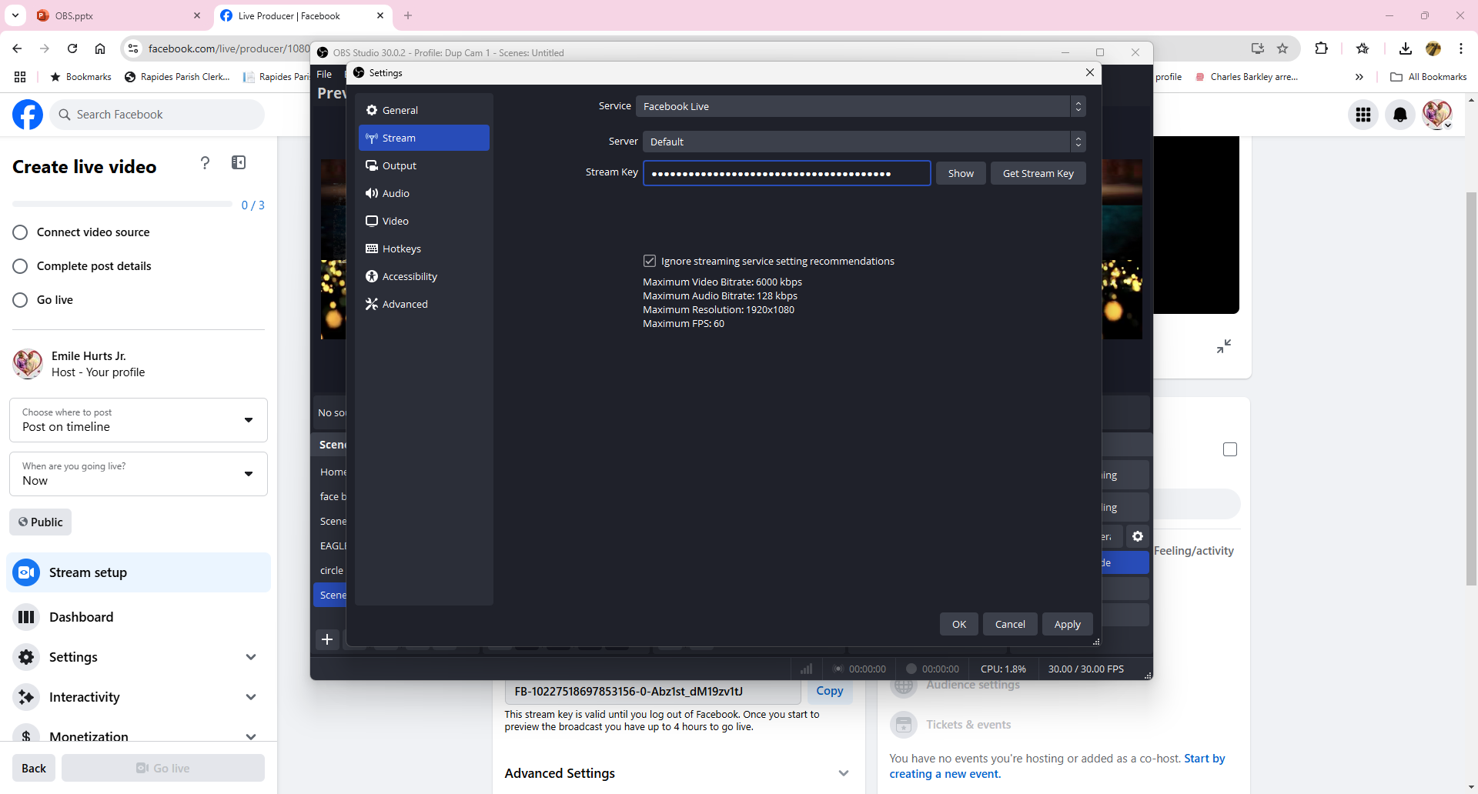
OBS Studio
Section 2. J
How to Broadcast Videos
Controls:
Stream Key
Right Click Blank Stream Key Paste
Left Click Apply
Click Ok
Return to OBS

Slide 28
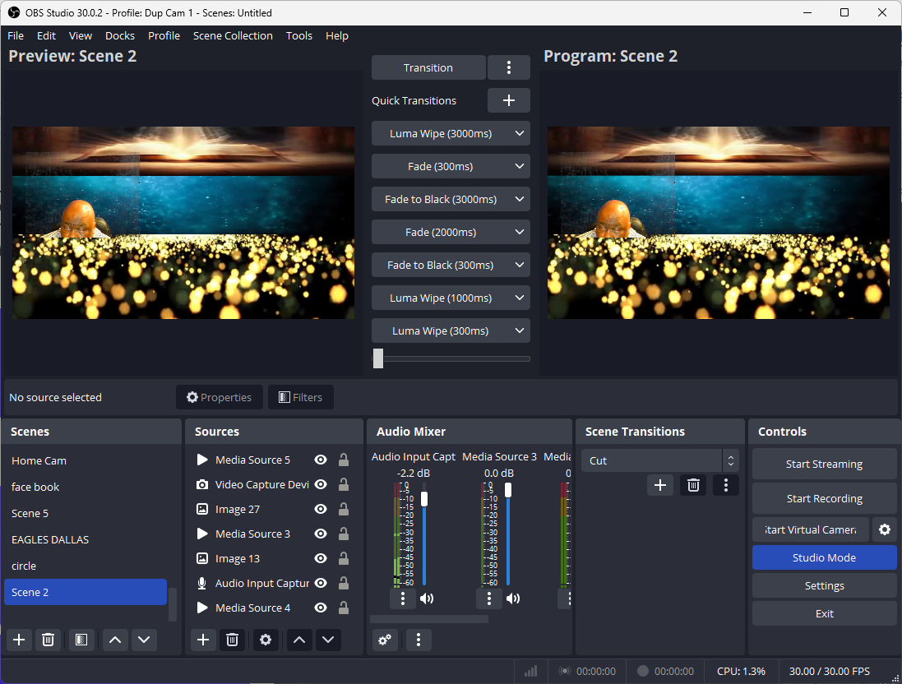
OBS Studio
Section 2. K
How to Broadcast Videos
Controls:
Stream Key
Right Click Blank Stream Key Paste
Left Click Apply
Click Ok
Return to OBS

Slide 29
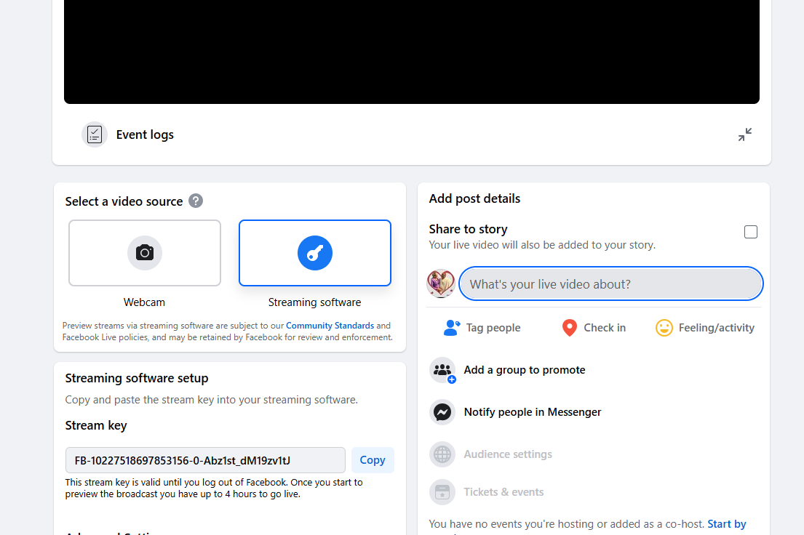
OBS Studio
Section 2. L
How to Broadcast Videos
Controls:
Stream Key
Left Click what’s your live video abour

Slide 30
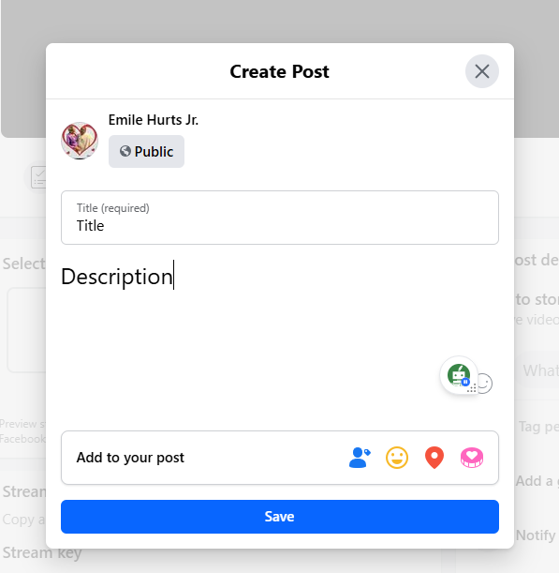
OBS Studio
Section 2. M
How to Broadcast Videos
Controls:
Stream Key
Must fill out
TITLE
DESCRIPTION
CLICK SAVE

Slide 31
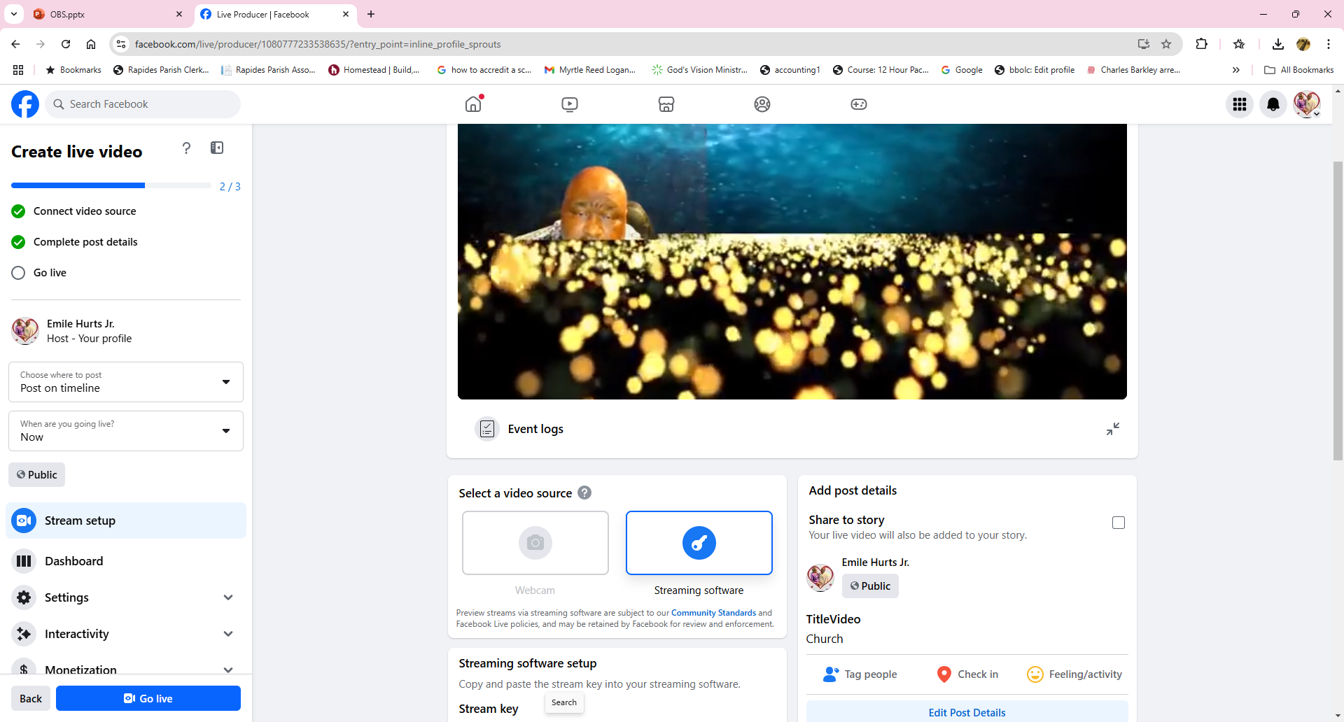
OBS Studio
Section 2. N
How to Broadcast Videos
Controls:
Stream Key
To Go Live on Facebook
all three green checks must appear
when you Press Go Live

Slide 32
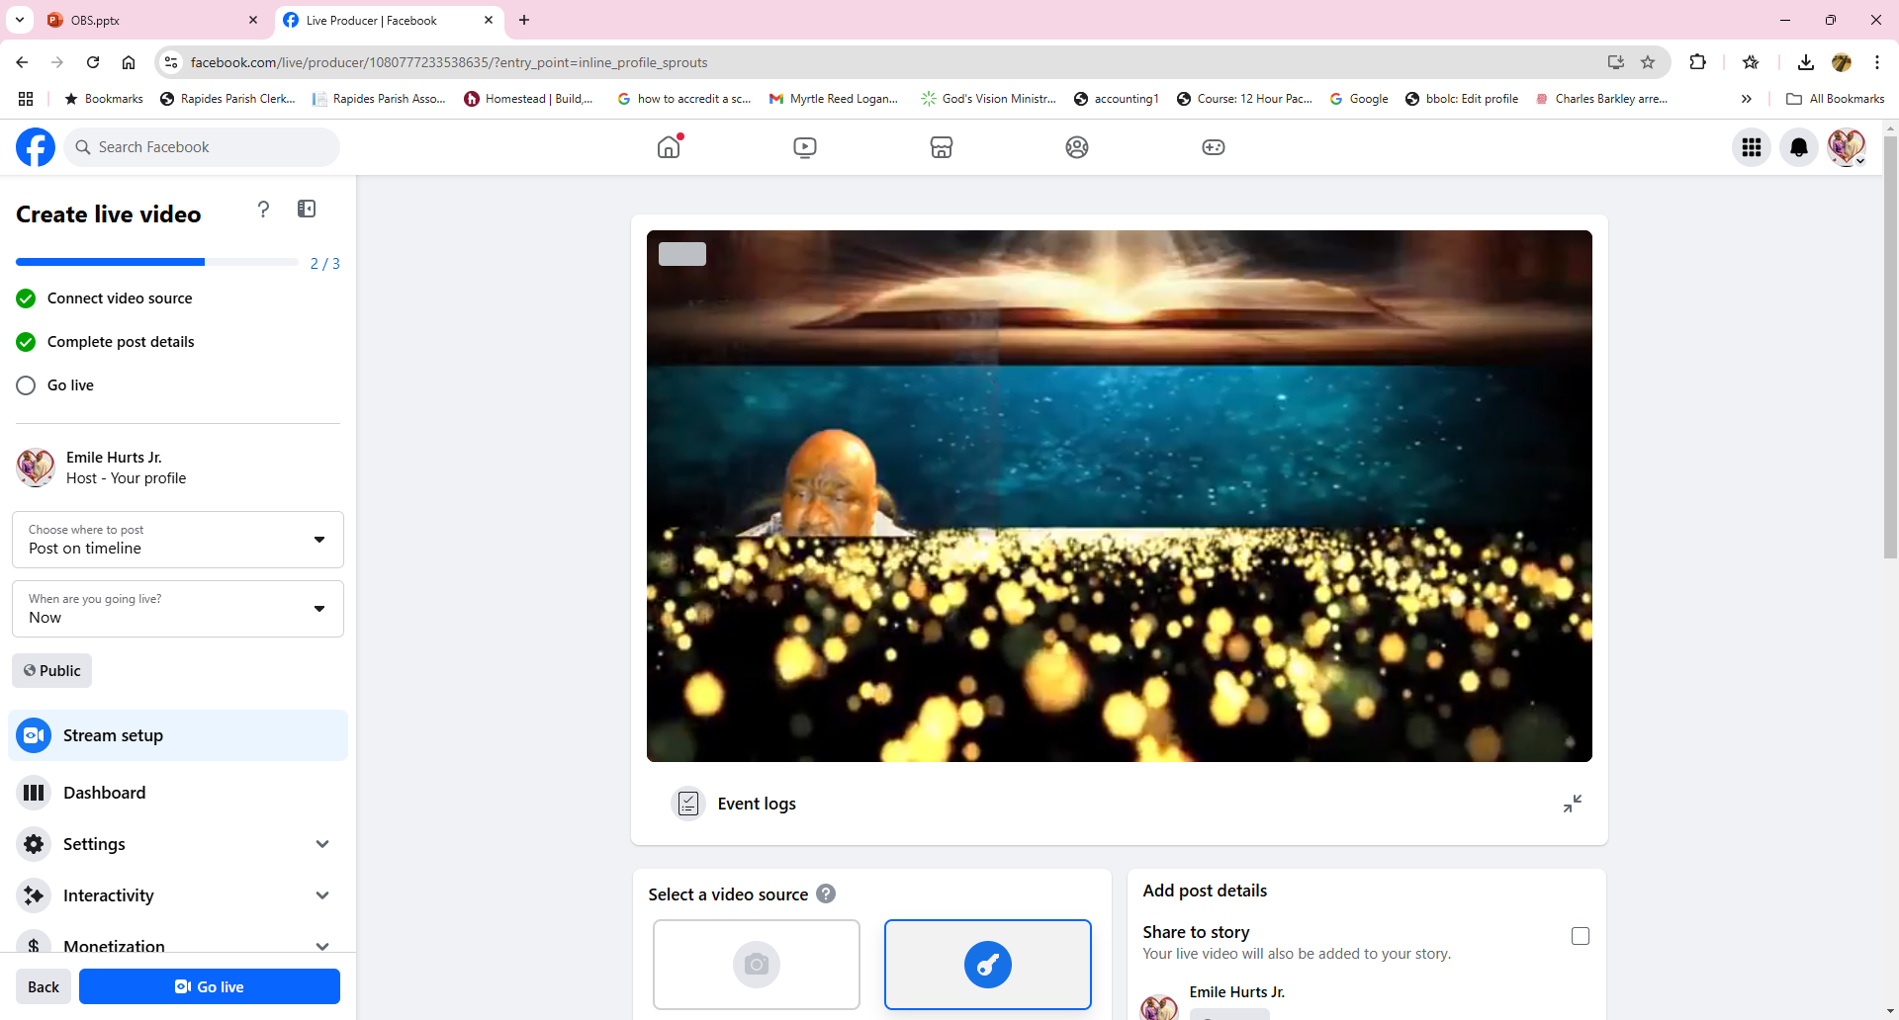
OBS Studio
How to Broadcast Videos
Controls:
Stream Key
To Go Live on Facebook
all three green checks must appear
when you Press Go Live

Slide 33
OBS Studio
How to Place Photo’s in Broadcast Videos
How to Broadcast Videos
Controls:
Stream Key
To Go Live on Facebook
all three green checks must appear
when you Press Go Live
Section 3

Slide 34
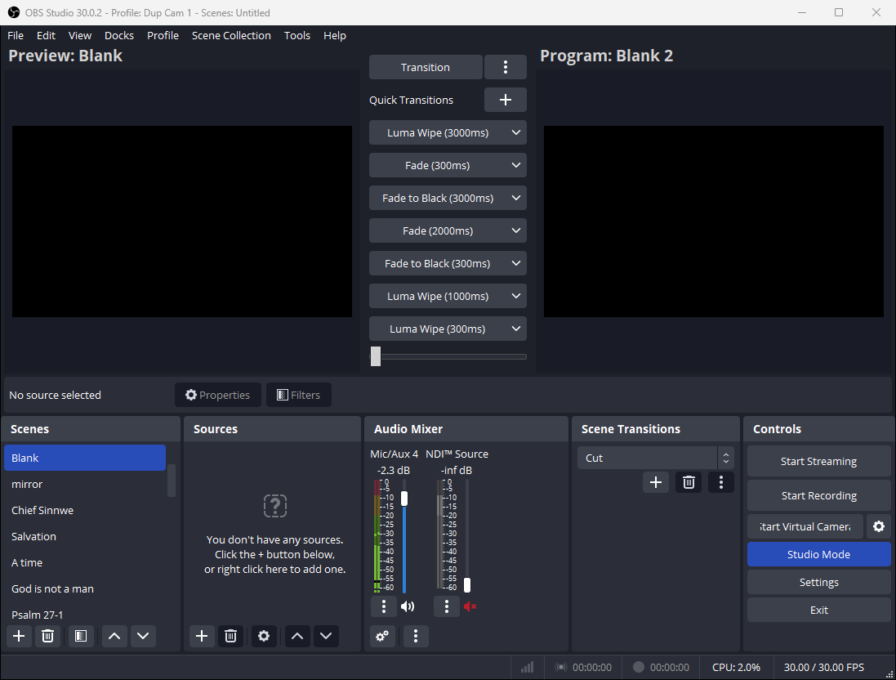
OBS Studio
How to Place Photo’s in Broadcast Videos
Section 3.1
Right click in Sources

Slide 35
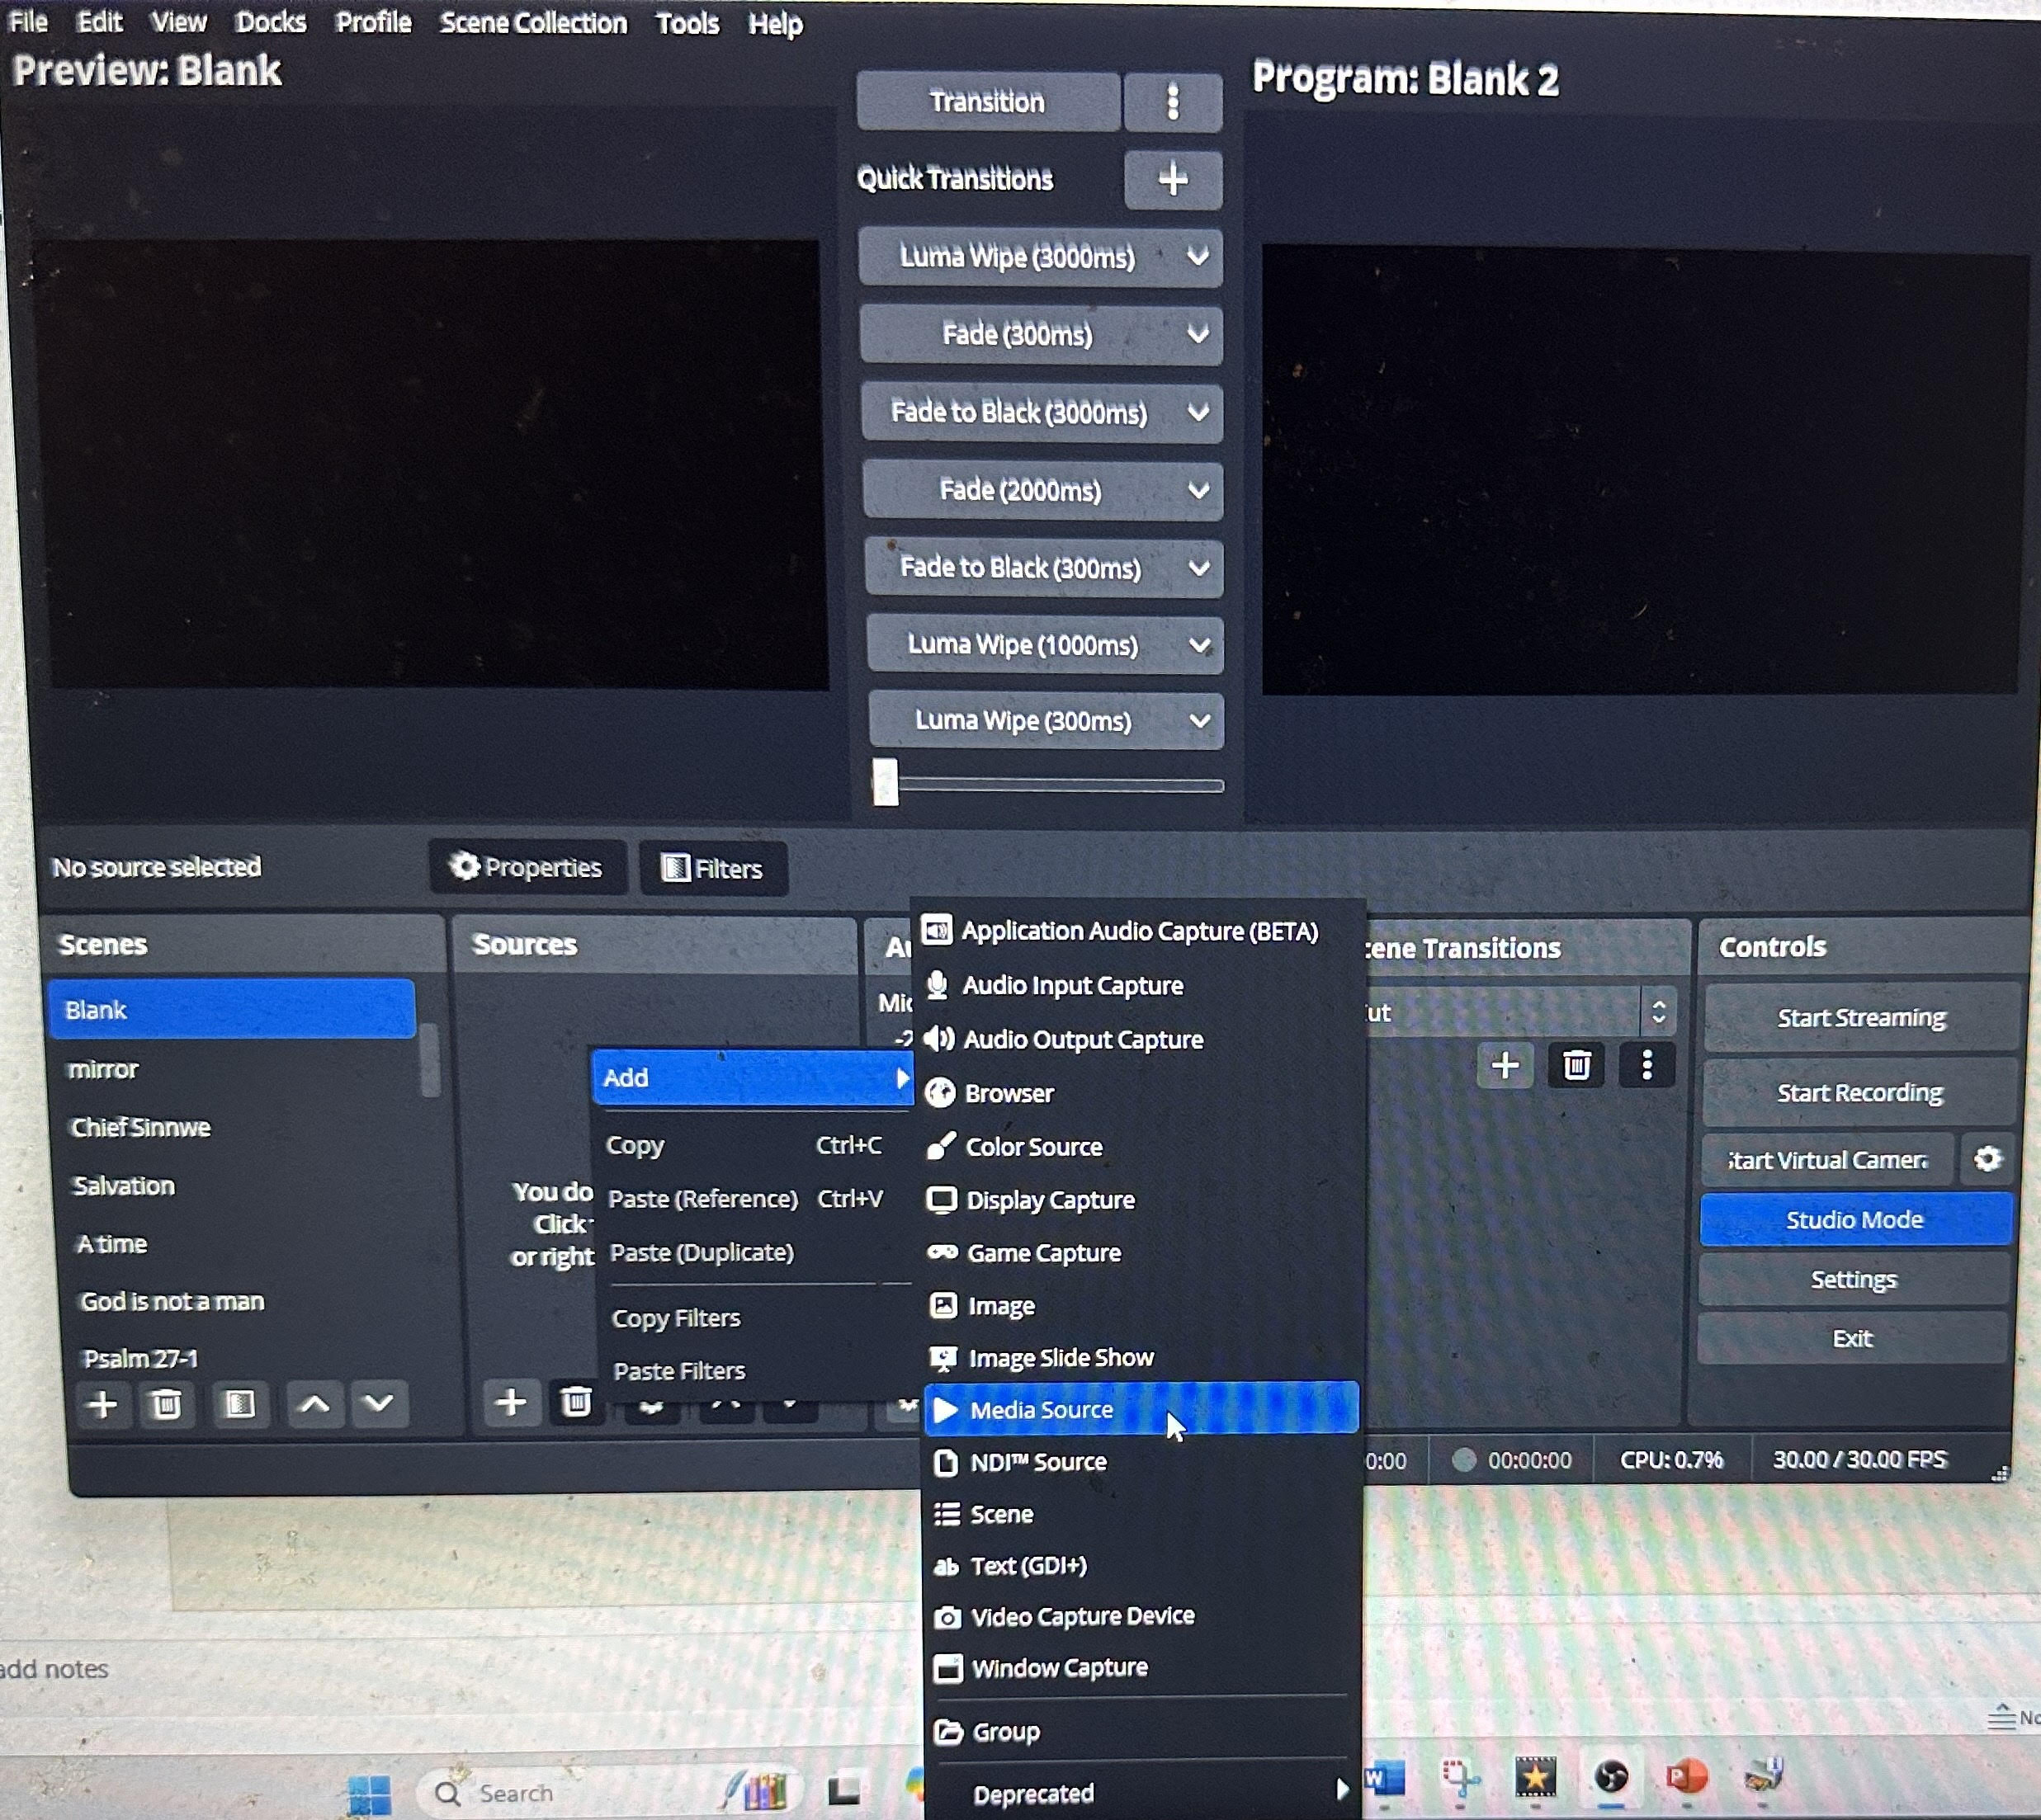

OBS Studio
How to Place Photo’s in Broadcast Videos
Section 3.2
Right click in Sources Add
Click on Video Capture Device

Slide 36
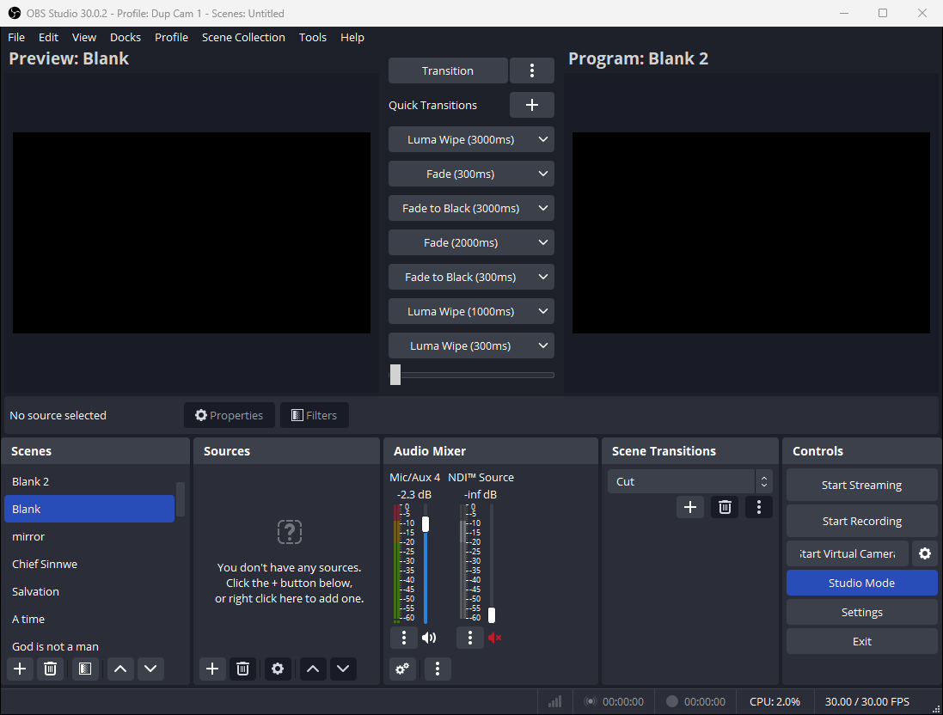
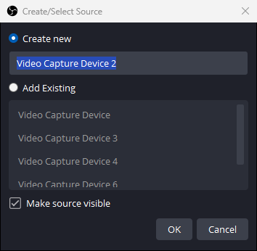
OBS Studio
How to Place Photo’s in Broadcast Videos
Section 3.3
Click on OK

Slide 37
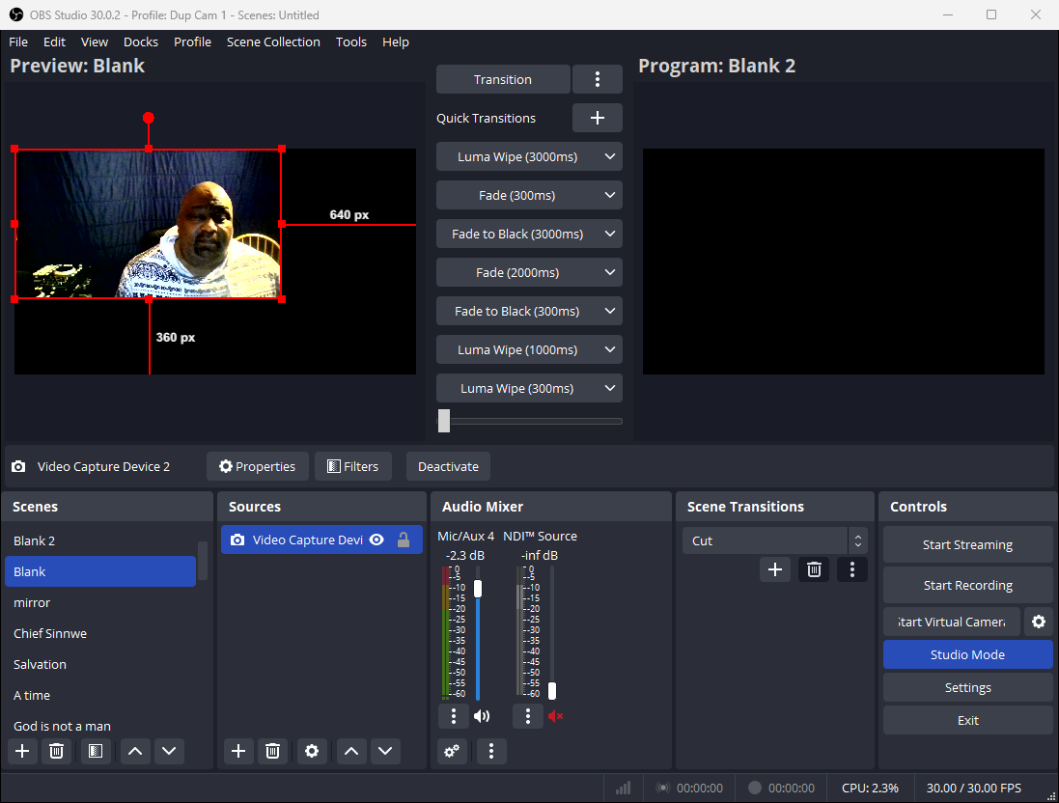
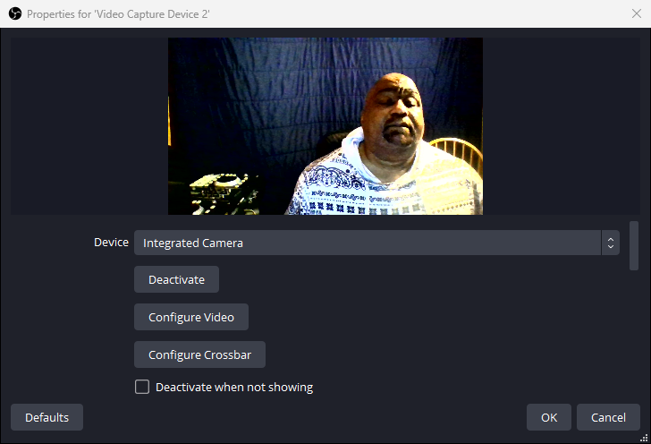
OBS Studio
How to Place Photo’s in Broadcast Videos
Section 3.4
Video Will appear in Preview Blank
In device Slot
Toggle up or down to choose which camera to use

Slide 38
OBS Studio
How to Place Photo’s in Broadcast Videos
Section 3.5
Adjust the size of your video
Right Click to add in empty source Place

Slide 39
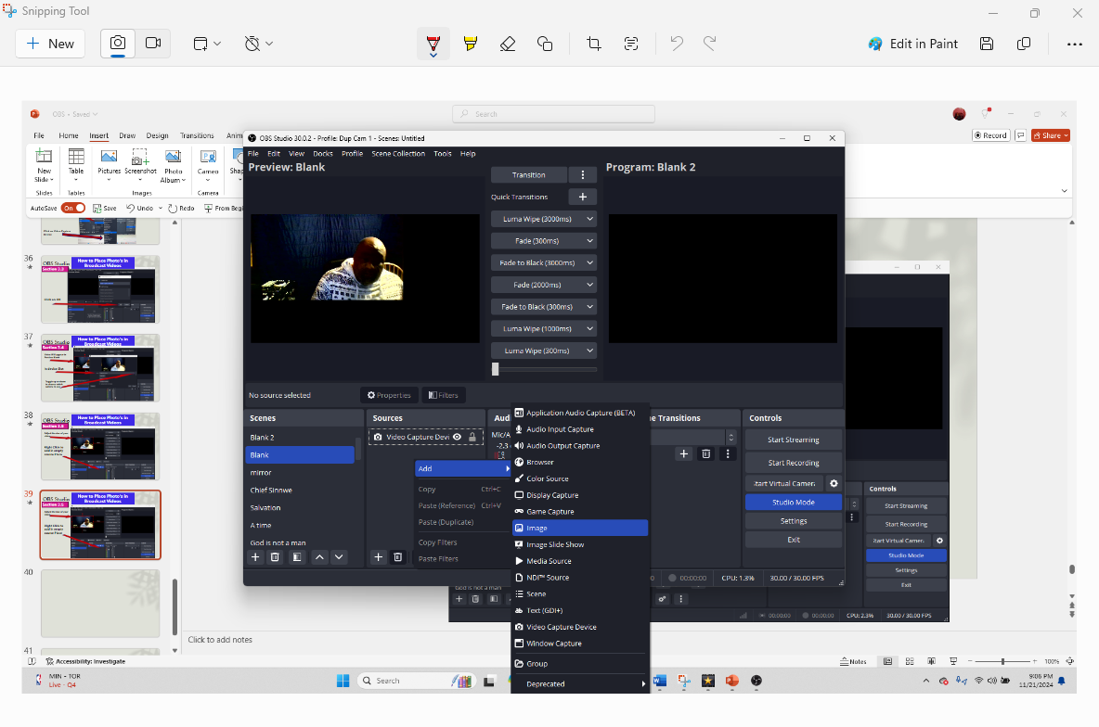
OBS Studio
How to Place Photo’s in Broadcast Videos
Section 3.6
Right Click add hold down left click on Image

Slide 40
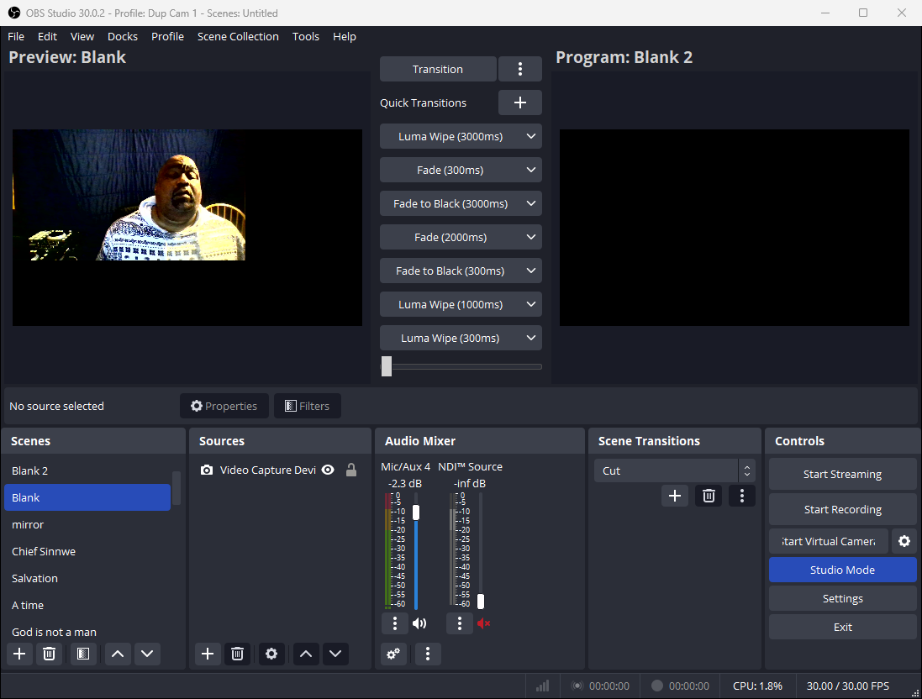
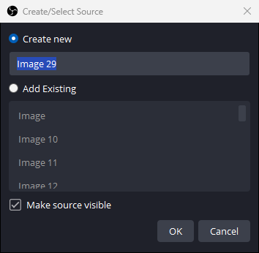
OBS Studio
How to Place Photo’s in Broadcast Videos
Section 3.7
Click OK

Slide 41
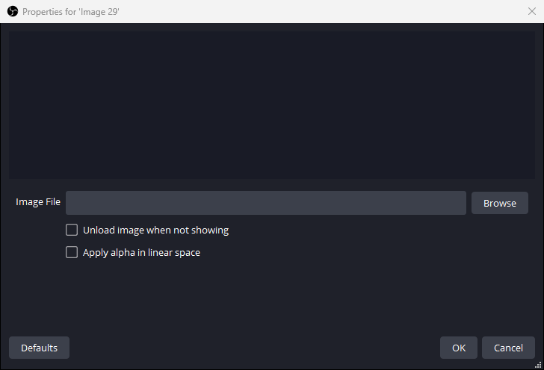
OBS Studio
How to Place Photo’s in Broadcast Videos
Section 3.8
Click Browse

Slide 42
OBS Studio
How to Place Photo’s in Broadcast Videos
Section 3.9
Click Browse

Slide 43
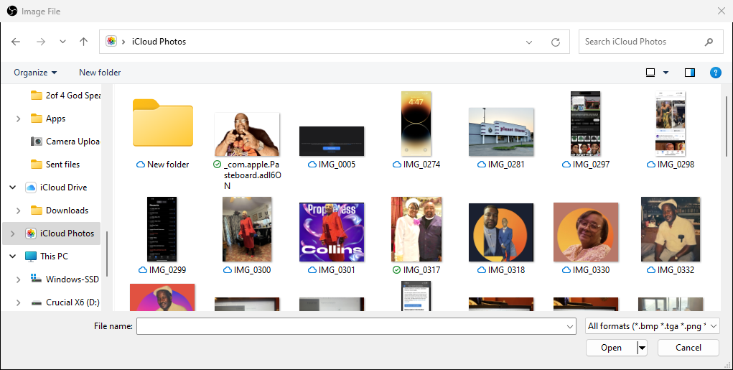
OBS Studio
How to Place Photo’s in Broadcast Videos
Section 3.a1
Click Picture or File

Slide 44
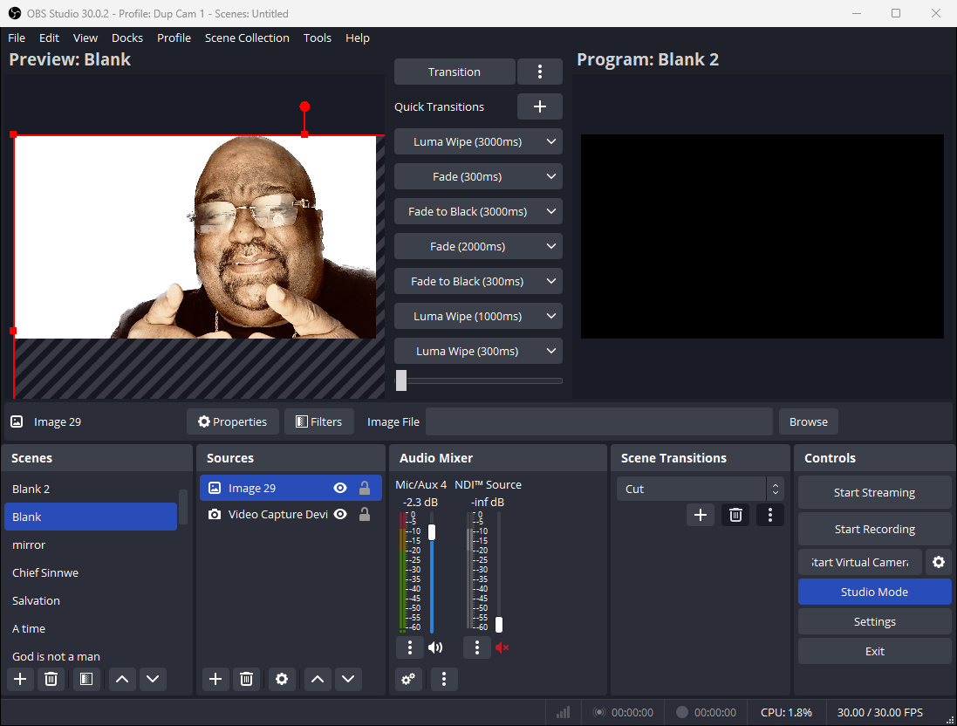
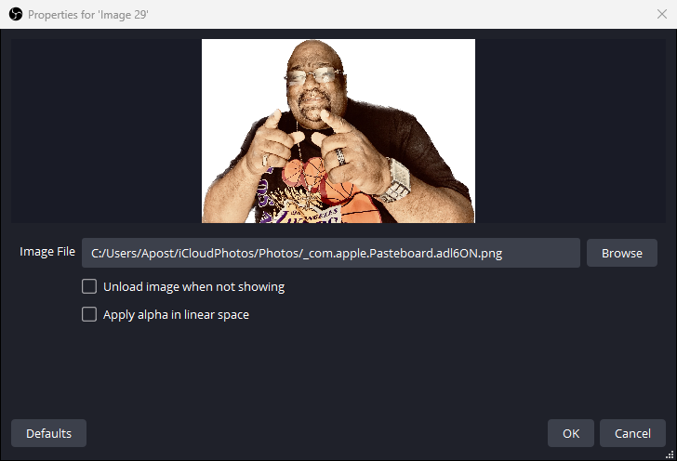
OBS Studio
How to Place Photo’s in Broadcast Videos
Section 3.a2
Click OK

Slide 45
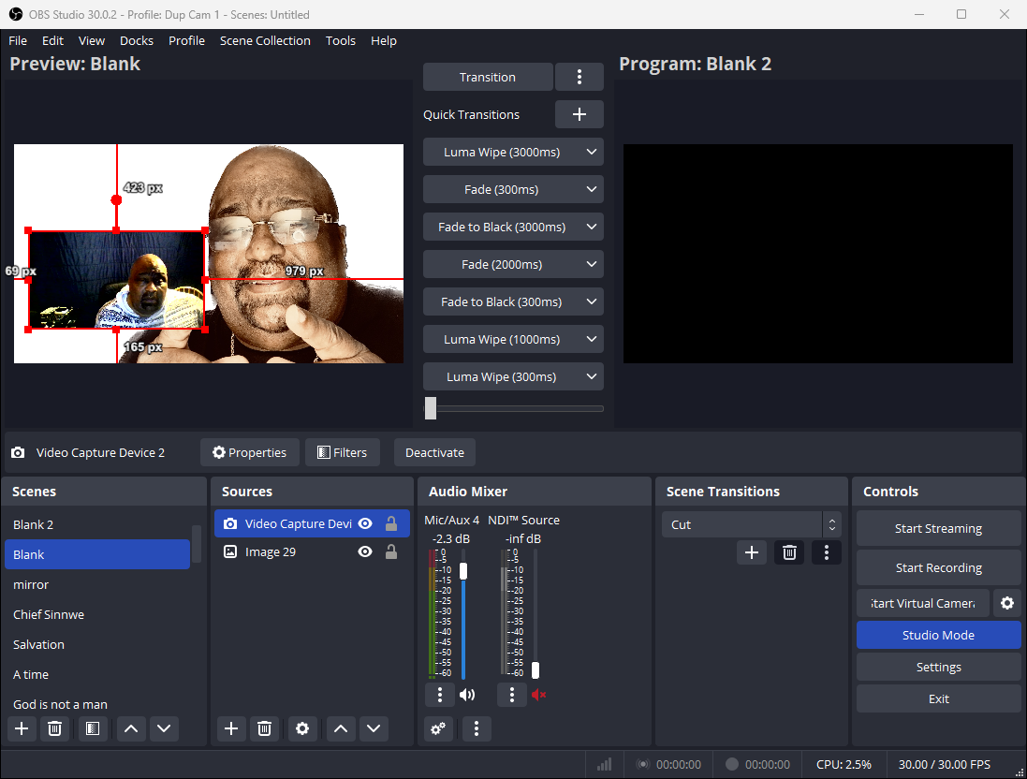
OBS Studio
How to Place Photo’s in Broadcast Videos
Section 3.a3
Move transition from left to right

Slide 46
OBS Studio
How to Place Photo’s in Broadcast Videos
Section 3.a2
Left Click on Image hold it
Down pull below virtual capture device and release

Slide 47
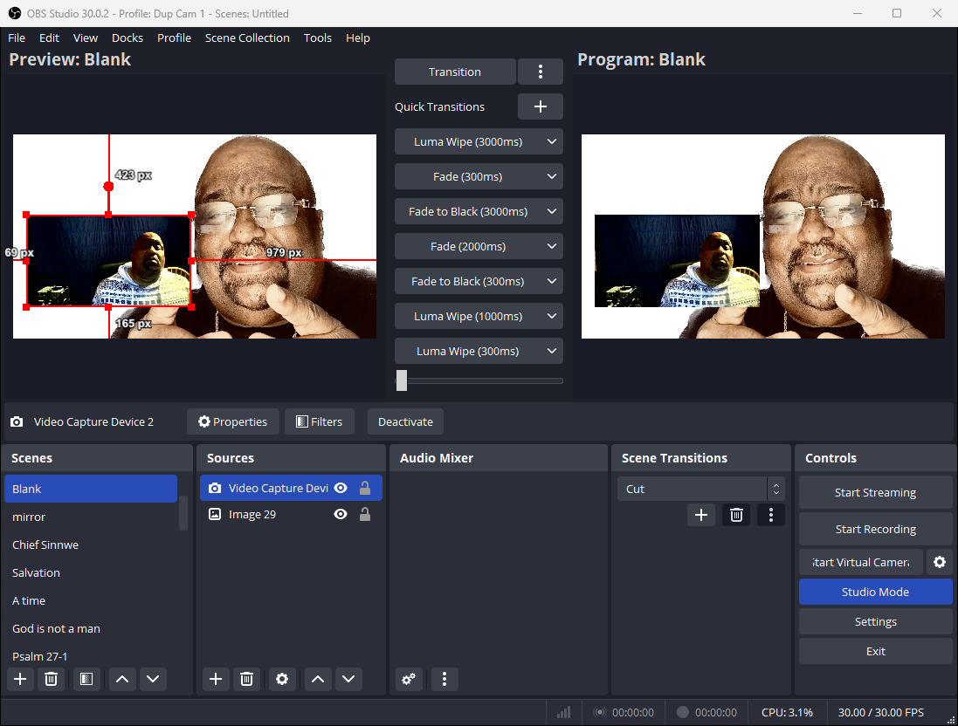
OBS Studio
How to Place Photo’s in Broadcast Videos
Section 3.a4
Ready to record or broadcast

Slide 48
How to Guide OBS Studio
1 of 3
Dr. Emile Hurts Jr.

Slide 49

How to Guide OBS Studio
2 of 3
Multiple Camera
Green Screen
Motion Background
Dr. Emile Hurts Jr.

Slide 50
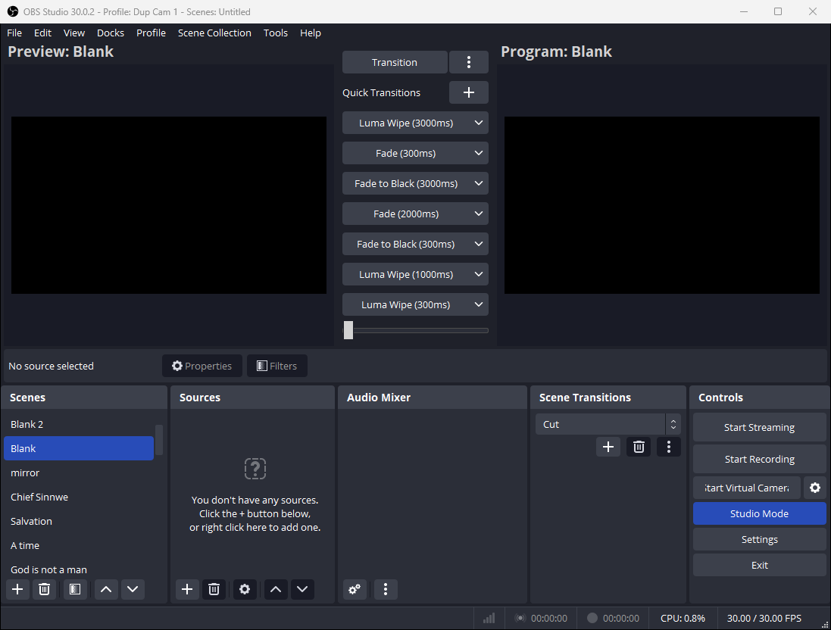
How to Guide OBS Studio 2 of 3
Multiple Camera
Section MC 1
Click on Studio Mode
Dr. Emile Hurts Jr.

Slide 51
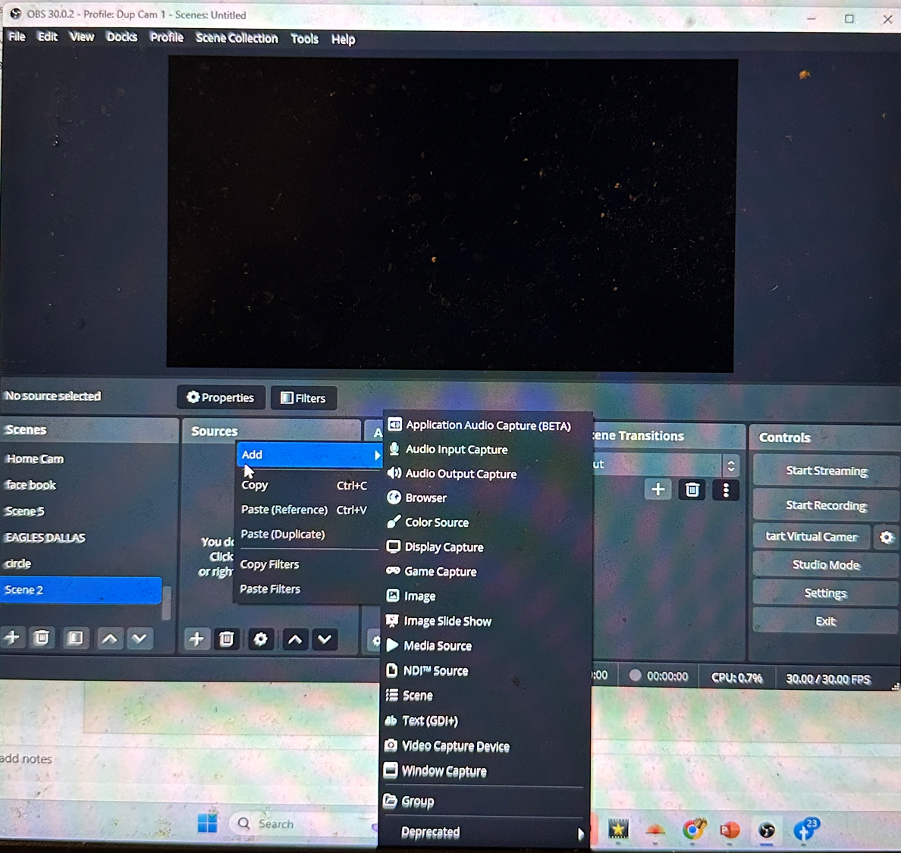
How to Guide OBS Studio 2 of 3
Multiple Camera
Section MC 2
Right Click in sources blank until add appears move cursor holding it down to video capture device
Dr. Emile Hurts Jr.

Slide 52
How to Guide OBS Studio 2 of 3
Multiple Camera
Section MC 3
Back space in blue space
Name Video Capture Camera,
Click OK
Dr. Emile Hurts Jr.

Slide 53
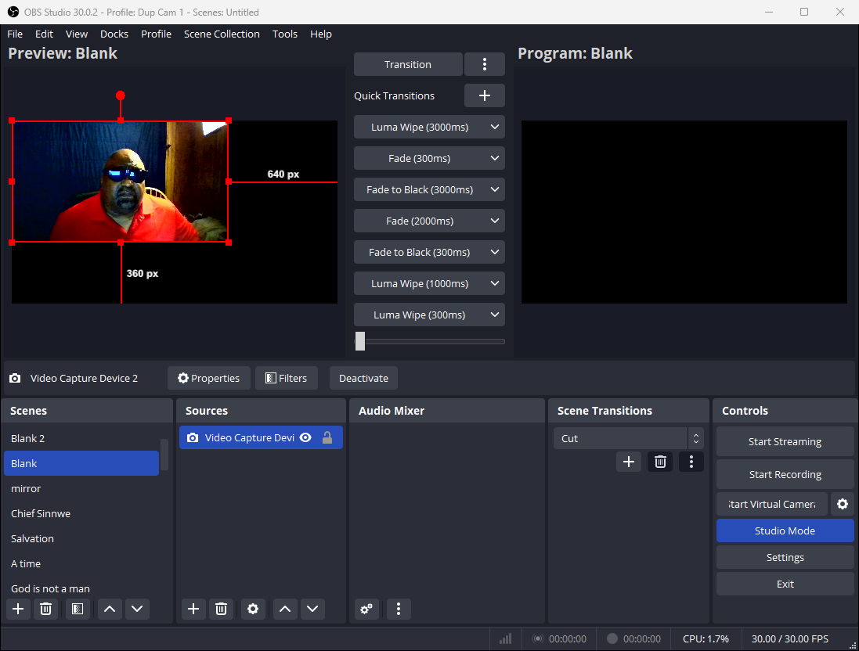
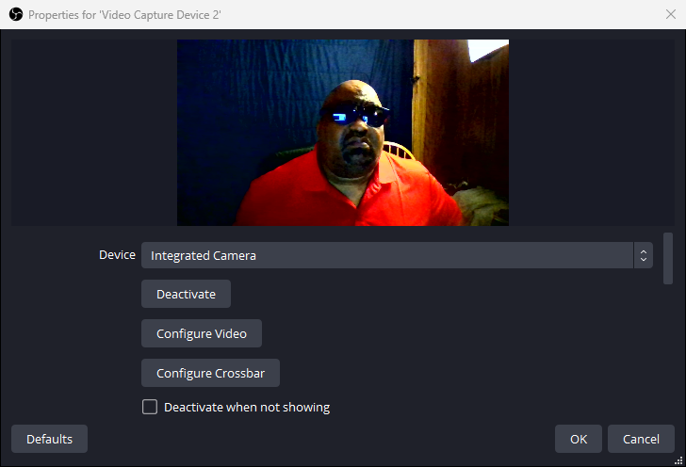
How to Guide OBS Studio 2 of 3
Multiple Camera
Section MC 4
Toggle up or down to choose Camera
Dr. Emile Hurts Jr.

Slide 54
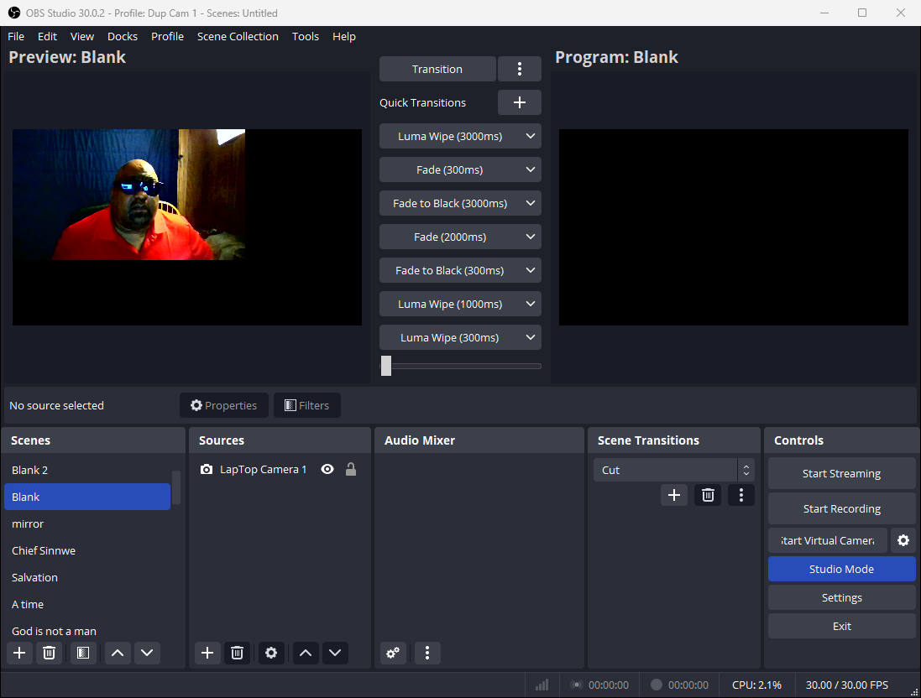
How to Guide OBS Studio 2 of 3
Multiple Camera
Section MC 5
To add extra Camera right click under blank space in sources
Dr. Emile Hurts Jr.

Slide 55
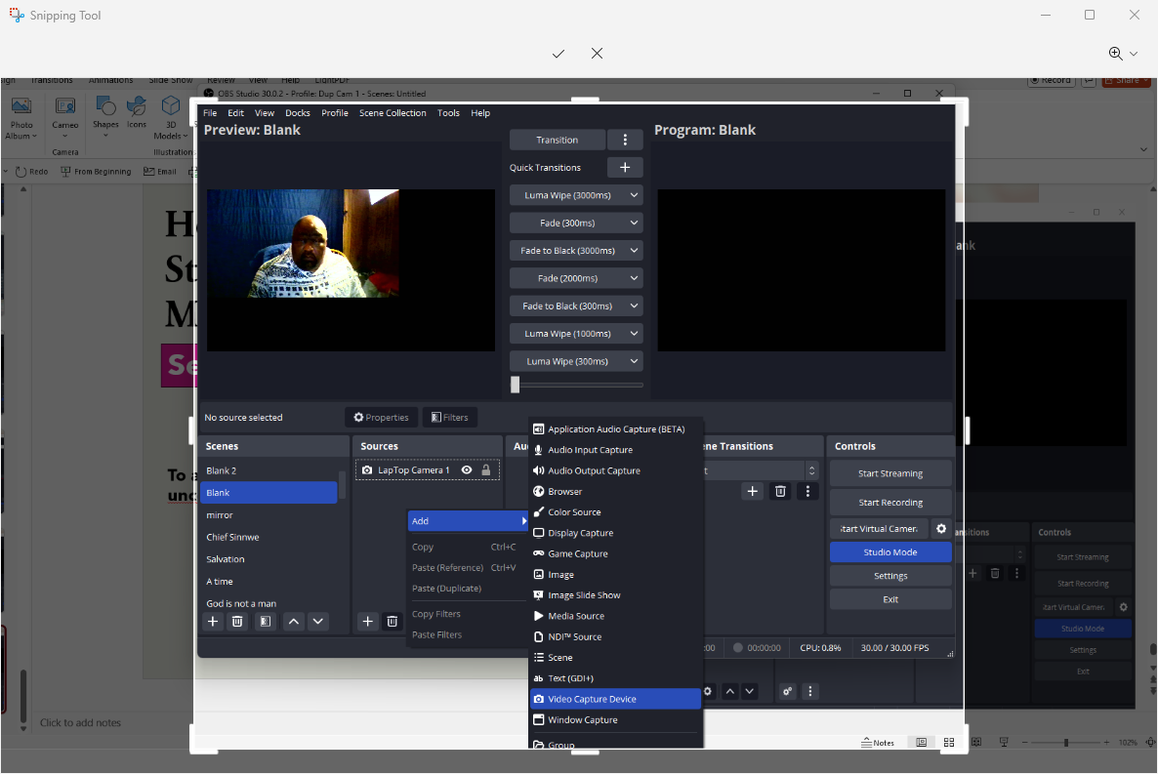
How to Guide OBS Studio 2 of 3
Multiple Camera
Section MC 6
Repeat section MC2
Right Click in sources blank until add appears move cursor holding it down to video capture device
Dr. Emile Hurts Jr.

Slide 56
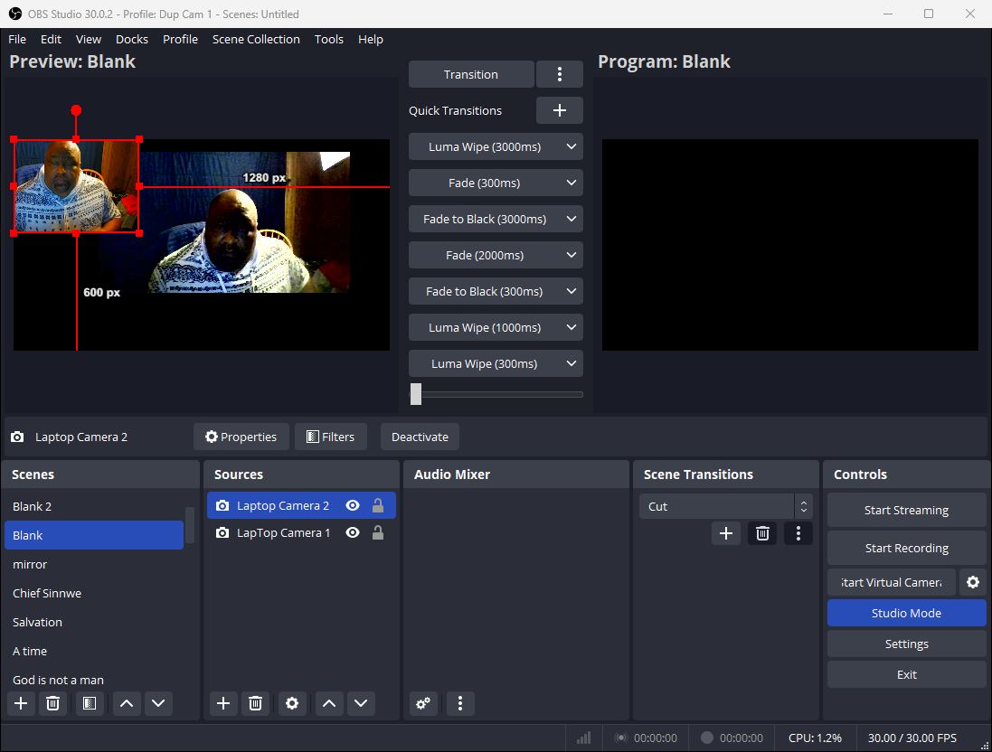
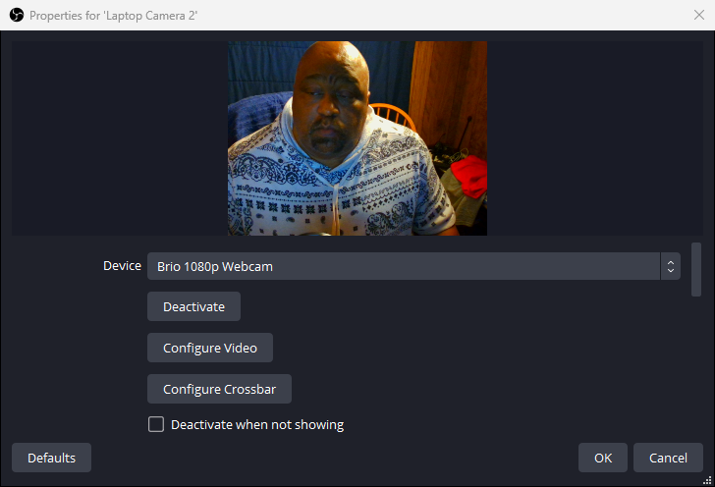
How to Guide OBS Studio 2 of 3
Multiple Camera
Section MC 7
Left Click OK
Dr. Emile Hurts Jr.

Slide 57
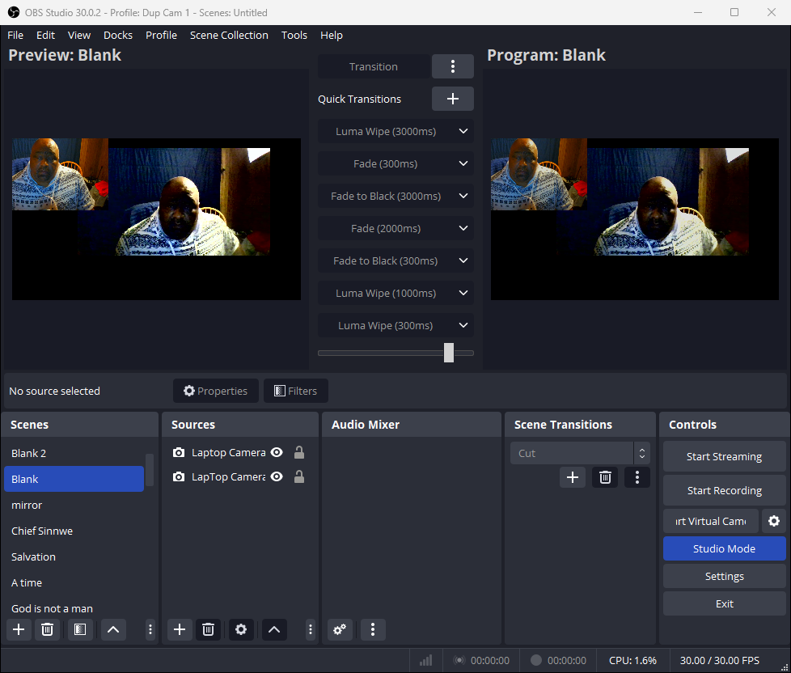
How to Guide OBS Studio 2 of 3
Multiple Camera
Section MC 8
Slide Quick Transition to thr right
Multiple Cameras
Dr. Emile Hurts Jr.

Slide 58
How to Guide OBS Studio
2 of 3
Green Screen
Dr. Emile Hurts Jr.

Slide 59
How to Guide OBS Studio 2 of 3
Green Screen
Section GS 1
How to Place a Image in Source
Dr. Emile Hurts Jr.

Slide 60
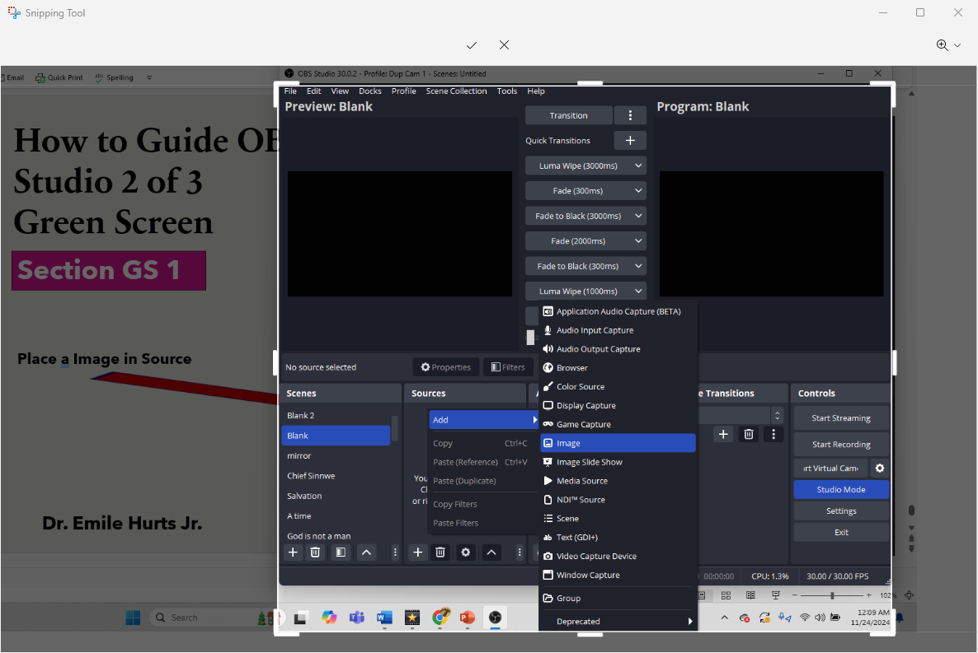
How to Guide OBS Studio 2 of 3
Green Screen
Section GS 2
Right Click in Source Add hold
Click on Image
Dr. Emile Hurts Jr.

Slide 61
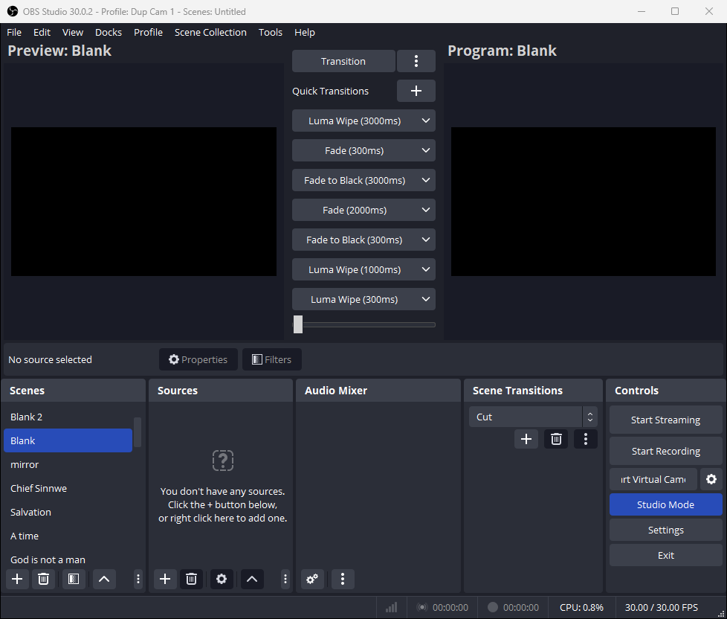
How to Guide OBS Studio 2 of 3
Green Screen
Section GS 3
Click Ok
Dr. Emile Hurts Jr.

Slide 62
How to Guide OBS Studio 2 of 3
Green Screen
Section GS 4
Click un Browse
Dr. Emile Hurts Jr.

Slide 63

How to Guide OBS Studio 2 of 3
Green Screen
Section GS 5
Click in Photo Storage
Click on Photo
then open
Dr. Emile Hurts Jr.

Slide 64

How to Guide OBS Studio 2 of 3
Green Screen
Section GS 6
Click OK
Dr. Emile Hurts Jr.

Slide 65

How to Guide OBS Studio 2 of 3
Green Screen
Section GS 7
Right Click on Image
Dr. Emile Hurts Jr.

Slide 66

How to Guide OBS Studio 2 of 3
Green Screen
Section GS 8
Right Click on Image
Hold down to transform
Hold move to arrow
Down to stretch to screen
Click stretch to screen
Stretxh to Screen
Dr. Emile Hurts Jr.

Slide 67

How to Guide OBS Studio 2 of 3
Green Screen
Section GS 9
Preview Scene should fill window
Dr. Emile Hurts Jr.

Slide 68

How to Guide OBS Studio 2 of 3
Green Screen
Section GS 10
Right click under sources
Under images
Click to video capture device
Dr. Emile Hurts Jr.

Slide 69
How to Guide OBS Studio 2 of 3
Green Screen
Section GS 11
Click to video capture device
Click OK
Dr. Emile Hurts Jr.

Slide 70

How to Guide OBS Studio 2 of 3
Green Screen
Section GS 12
Click to video capture device
Click OK
Dr. Emile Hurts Jr.

Slide 71

How to Guide OBS Studio 2 of 3
Green Screen
Section GS 13
Place cursor on video Capture Device Screen
Right Click
Dr. Emile Hurts Jr.

Slide 72


How to Guide OBS Studio 2 of 3
Green Screen
Section GS 14
Right Click
hold
Go to Filter
Dr. Emile Hurts Jr.

Slide 73

How to Guide OBS Studio 2 of 3
Green Screen
Section GS 15
Right Click
under effects filters
Dr. Emile Hurts Jr.

Slide 74

How to Guide OBS Studio 2 of 3
Green Screen
Section GS 16
Right Click
Add
Click chroma key
Dr. Emile Hurts Jr.

Slide 75
How to Guide OBS Studio
1 of 4
Transparent Screens
Dr. Emile Hurts Jr.

Slide 76

How to Guide OBS Studio 1 of 4
Transparent Screen
Section TS 1
Left Click
O K
Dr. Emile Hurts Jr.

Slide 77

How to Guide OBS Studio 1 of 4
Transparent Screen
Toggle between Blue / Green
preference
Section TS 2
Dr. Emile Hurts Jr.

Slide 78

How to Guide OBS Studio 1 of 4
Transparent Screen
Slide similarity button until the background goes dark and watch the picture adjust to the desired transparency
Section TS 3
Dr. Emile Hurts Jr.

Slide 79

How to Guide OBS Studio 2 of 4
Transparent Screen
Solid Backgrounds
Section TSSB 1
Right Click under source
Click add
Click image
Click Browser
Select Photo
Dr. Emile Hurts Jr.

Slide 80


How to Guide OBS Studio 2 of 4
Transparent Screen
Solid Backgrounds
Section TSSB 2
Place the stilus on picture
Click on transform
Click on stretch to screen
Or a more appropriate
Picture adjustments
Dr. Emile Hurts Jr.

Slide 81
How to Guide OBS Studio
Dr. Emile Hurts Jr.

